Slide 2
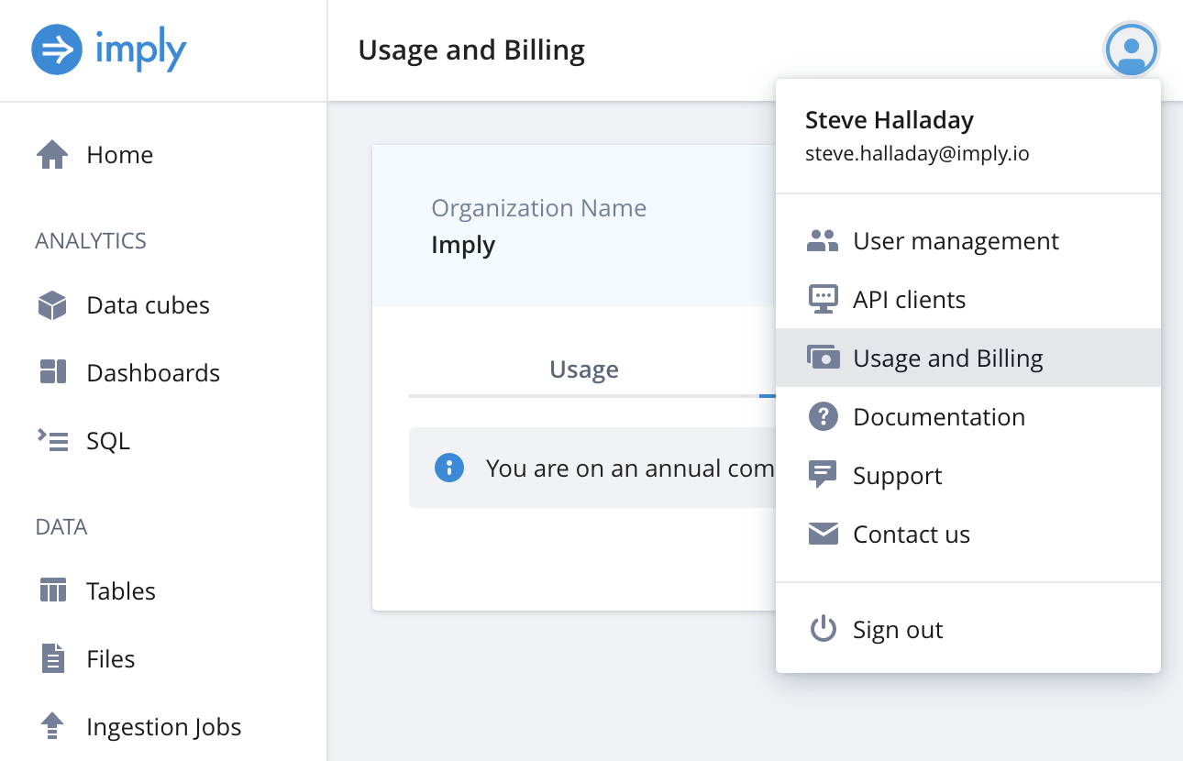


Click here
Then, click here
Find the organization name here

Slide 3
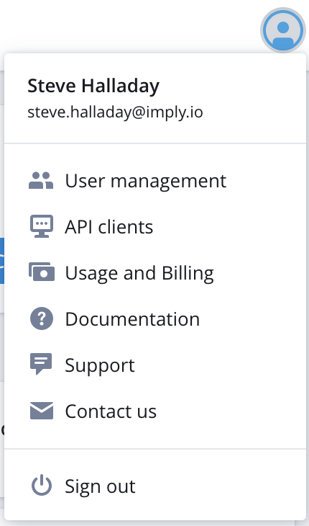

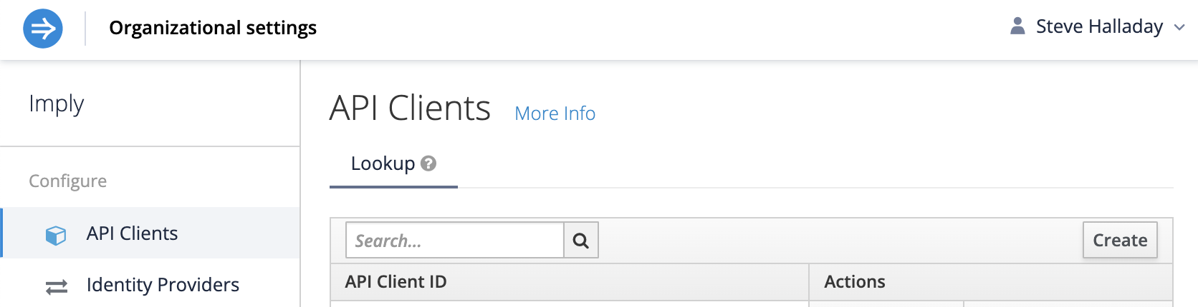
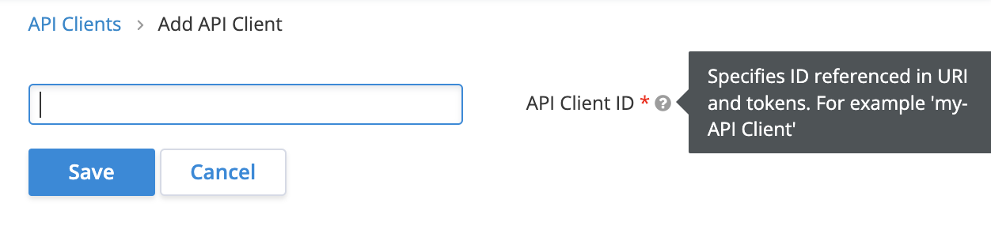
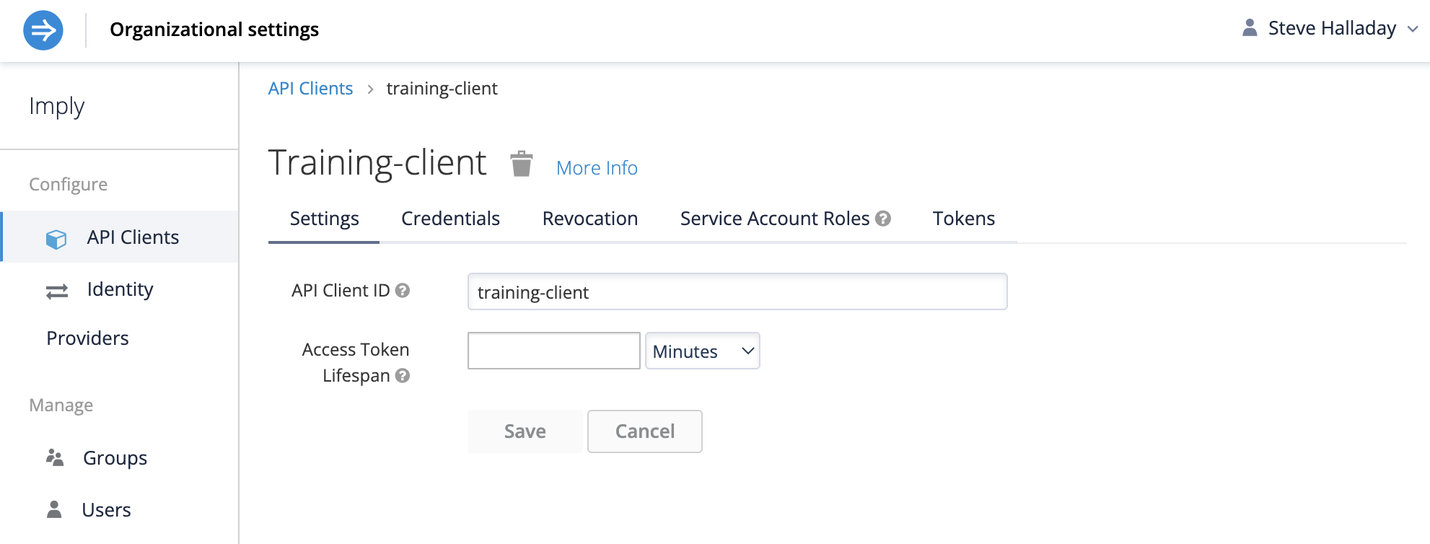
1 - Click here
2 - Click here
3 - click here
4 – Fill in the API client ID
5 - Click here
6 – Fill in the lifespan
(60 minutes ought to work)
7 – Click here

Slide 4
6 – Fill in the lifespan
(60 minutes ought to work)
7 – Click here

Slide 5
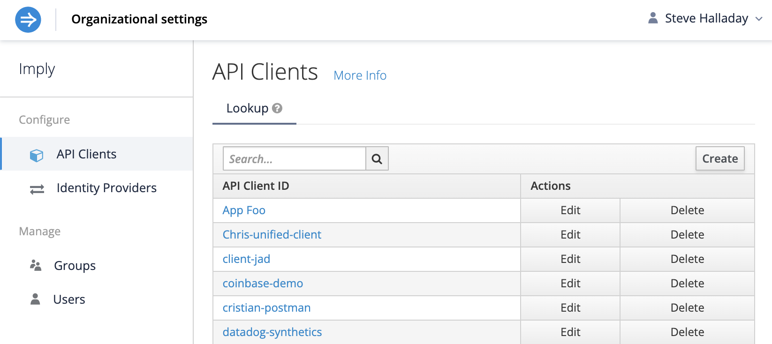

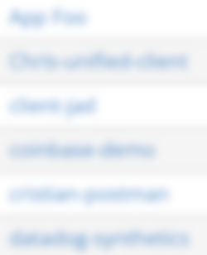
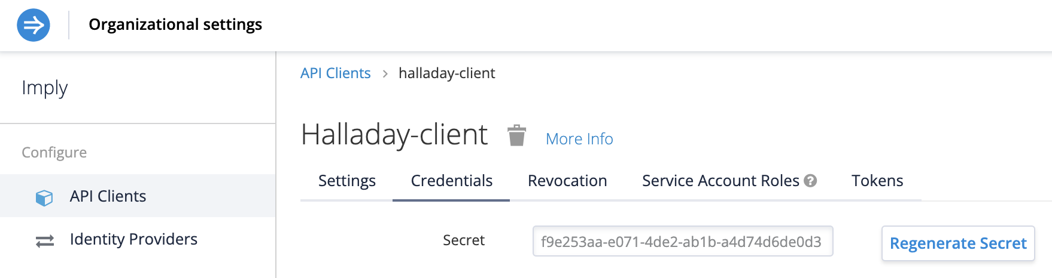


Select the client from the list
Click here
Copy this to the clipboard

Slide 6
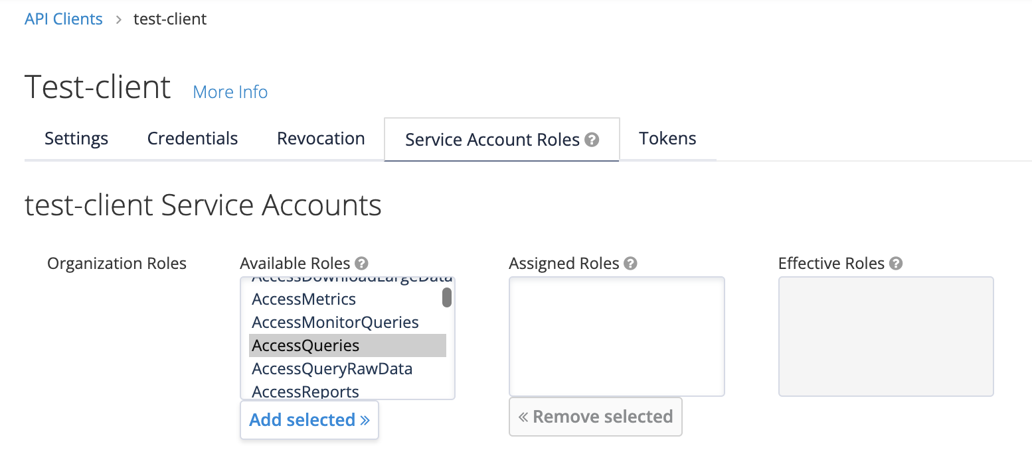



Click here
For each role,
Select the role
Add selected role
Select each role
Then, click here
Roles include:
AccessQueries
ManageFiles
ManageIngestionJobs
ManageStreams
ManageTables

Slide 7
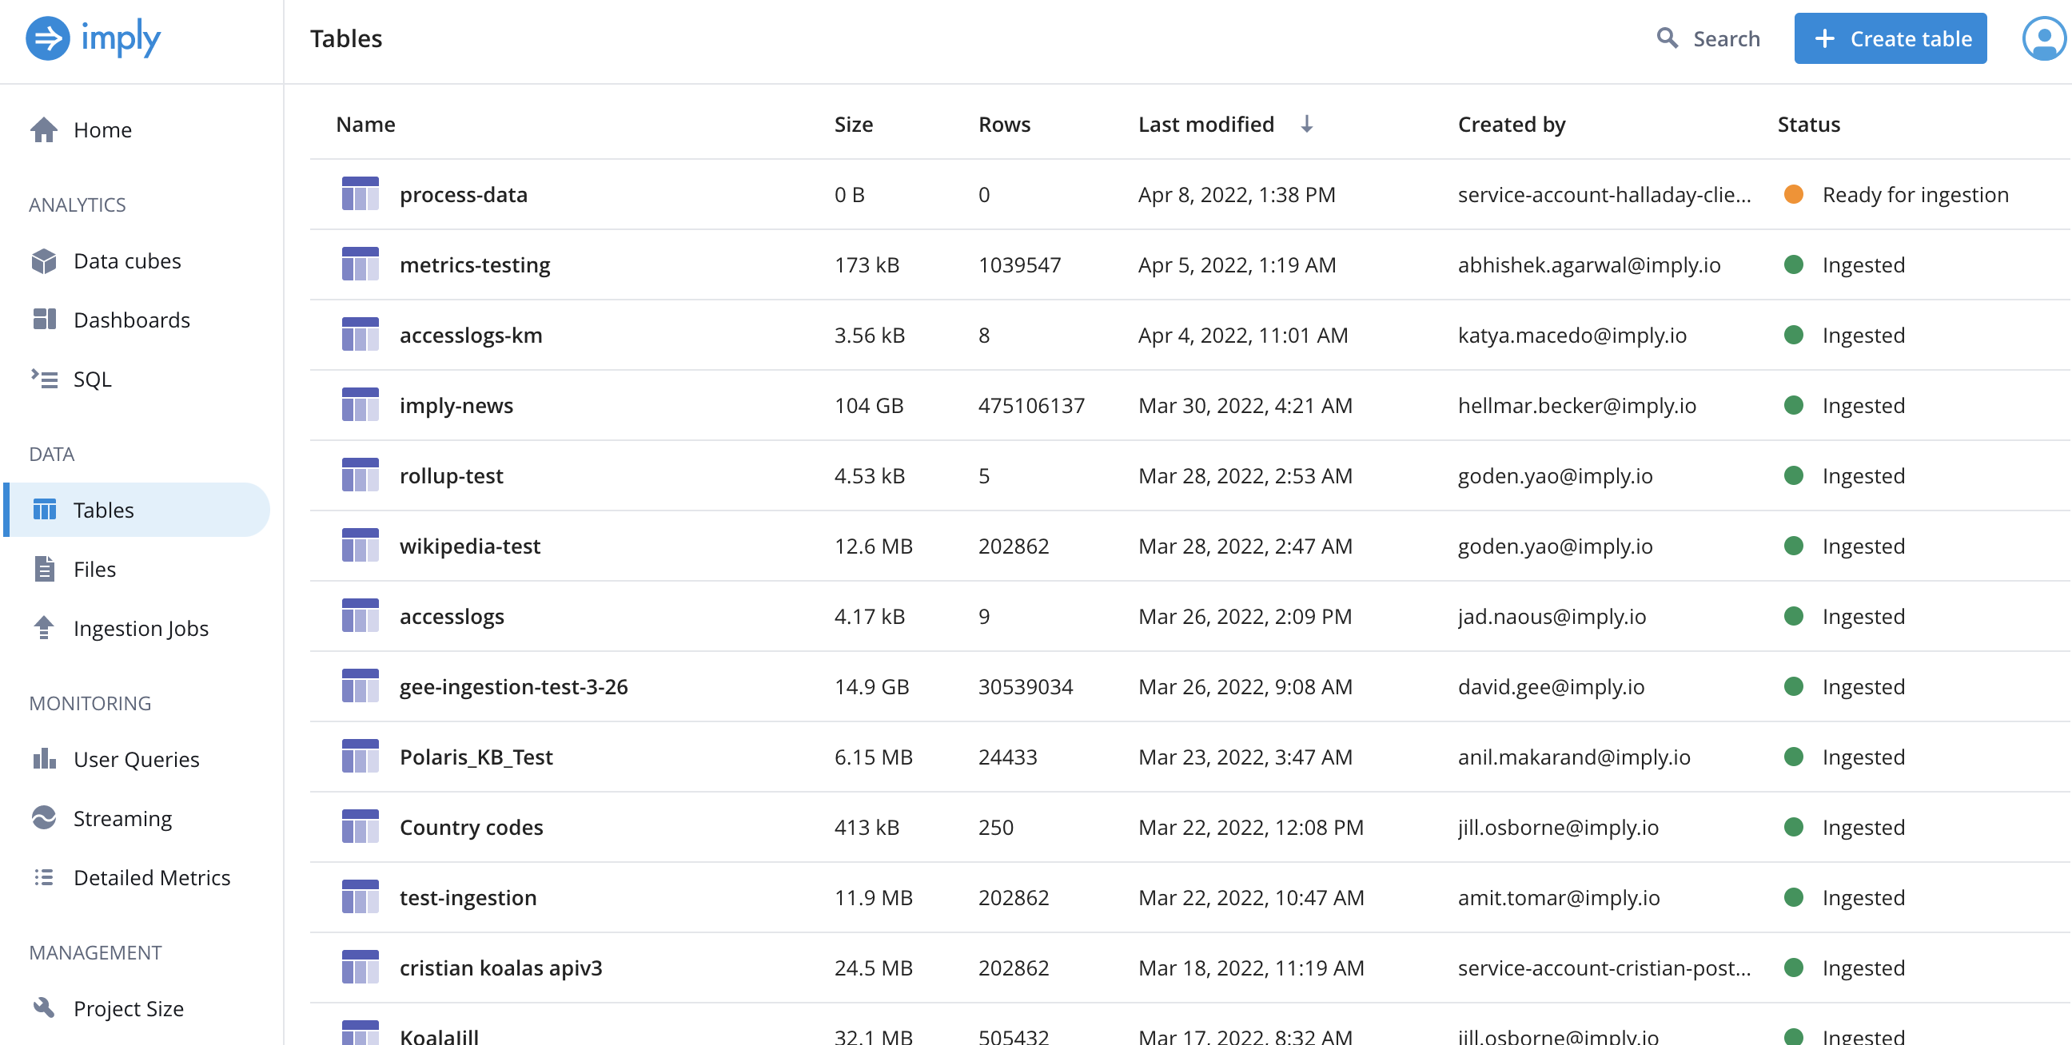

Click here
Then, click here

Slide 8
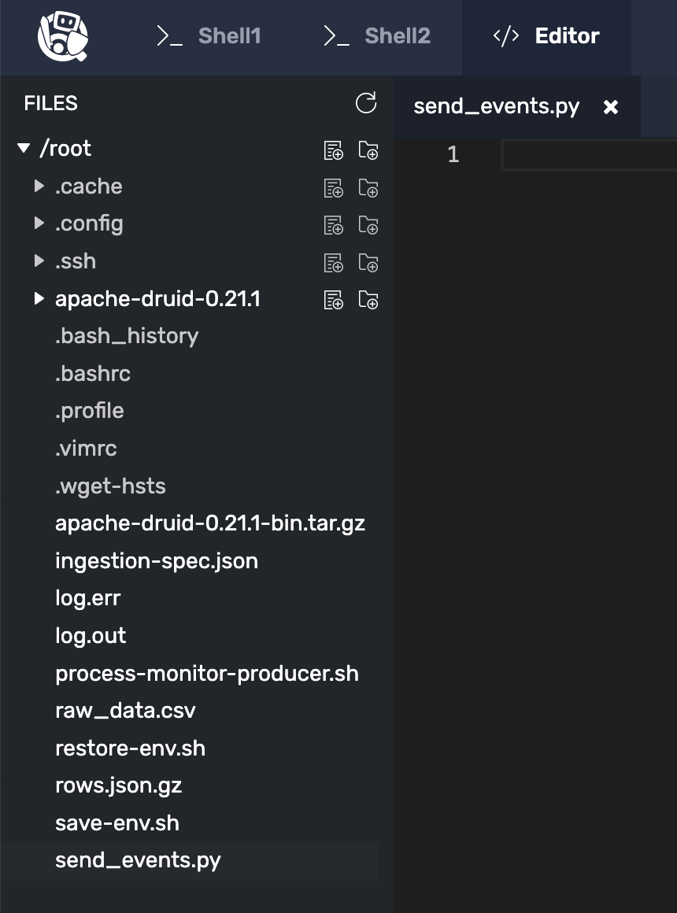
Click here
Then, click here

Slide 9



Click here to save the file
Click here
Click here
Click here

Slide 10

Click here to save the file
Click here
Click here
Click here

Slide 11

Create a Polaris Table

Slide 12
Setting Up a Druid Table
Migration details may vary
But the process is generally the same
SELECT COUNT(*) FROM table

Slide 13
This lesson covers the following:
Set up a local druid table
Signup for a free 60 day Polaris account
Create a Polaris table with a schema
Move the Druid table data to Polaris
Stream data to the Polaris table

Slide 14
Three pieces of info we need:
Organization name
API client ID
API client secret

Slide 15

A note about environment variables:
Our training environment requires us
to refresh them on each challenge.
You don’t need to do this in production.

Slide 16
Polaris Batch Data Migration
Things that may increase program complexity:
Event source
Event format
Type of batching

Slide 17
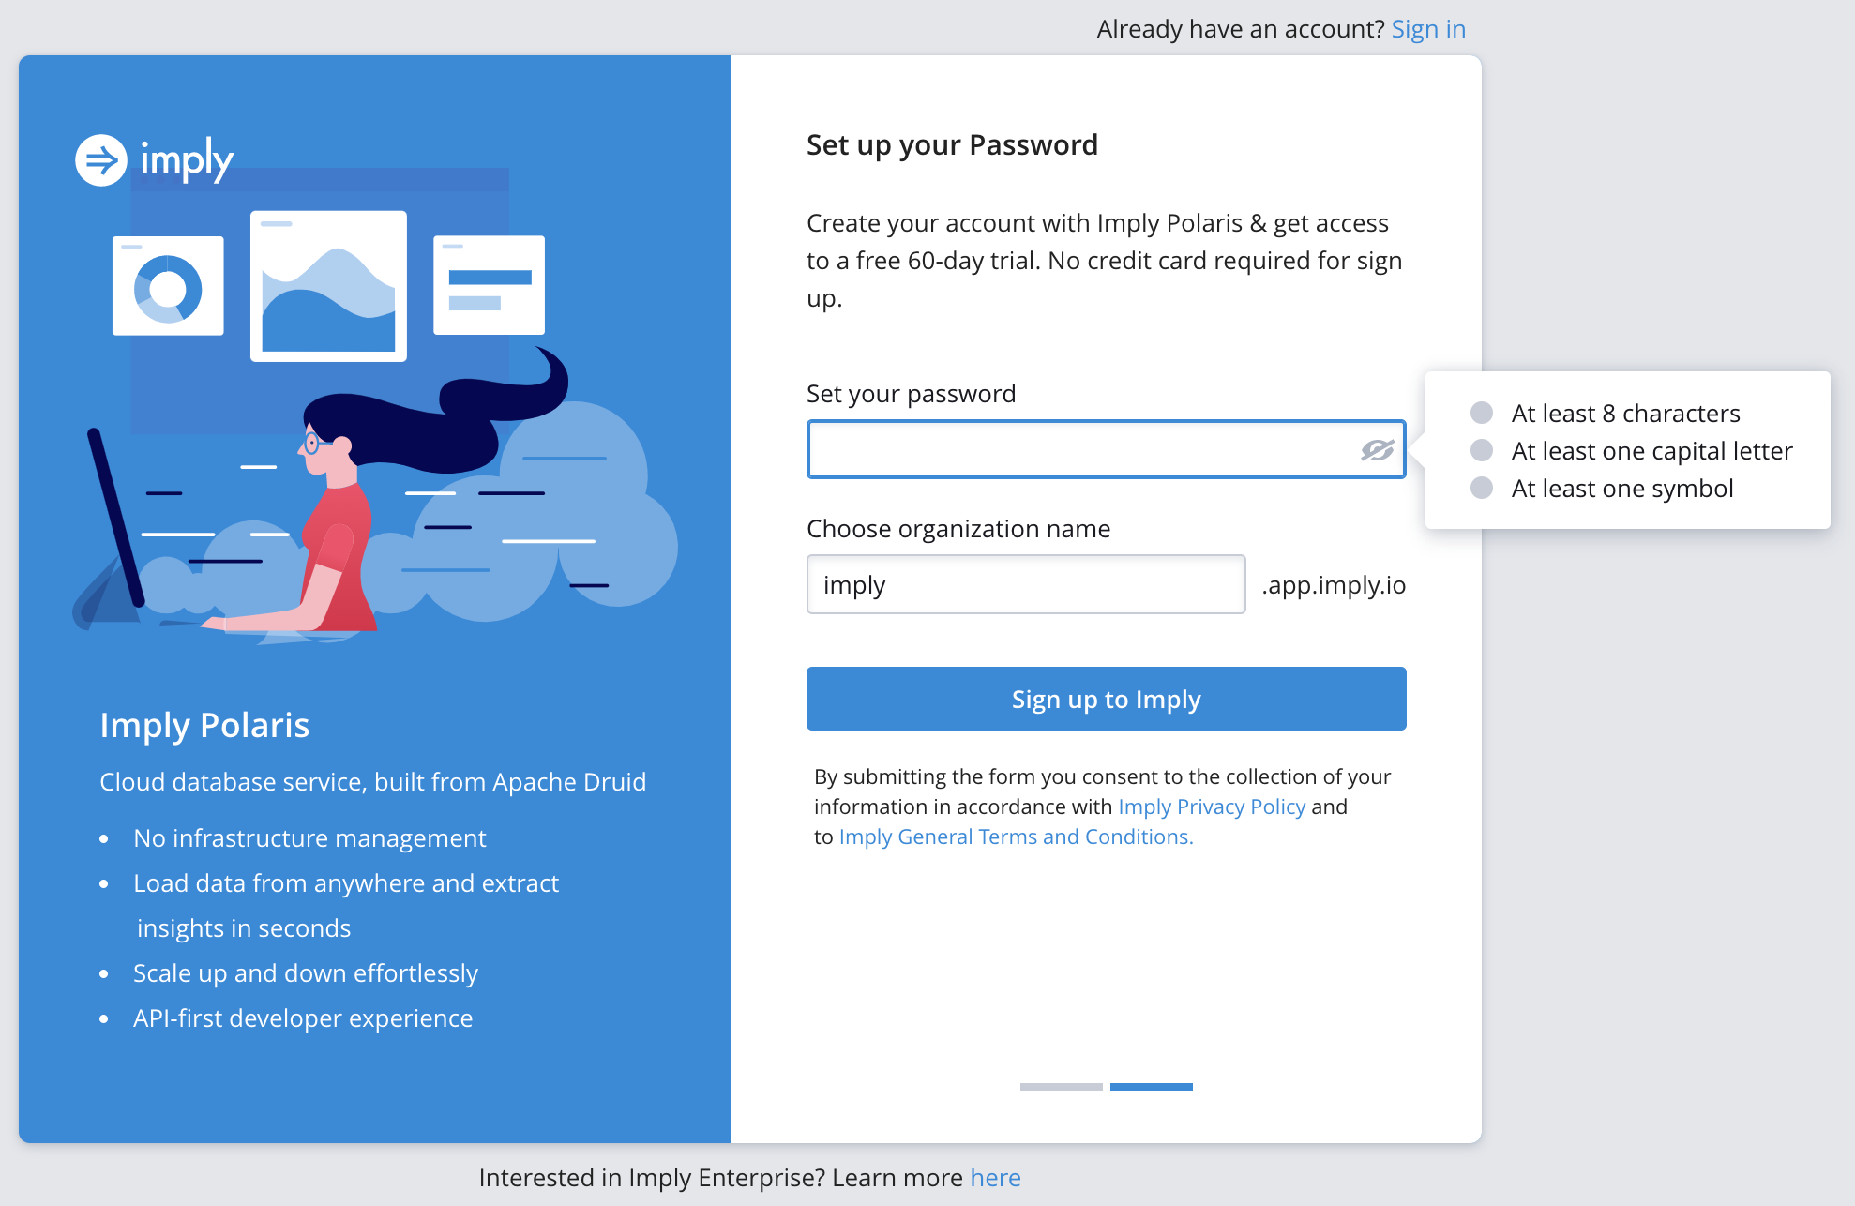


Slide 18



Slide 19
Migrating Data
From
Apache Druid® to Polaris
What is Polaris?
Apache Druid®
Polaris
(SaaS by Imply)

Slide 20


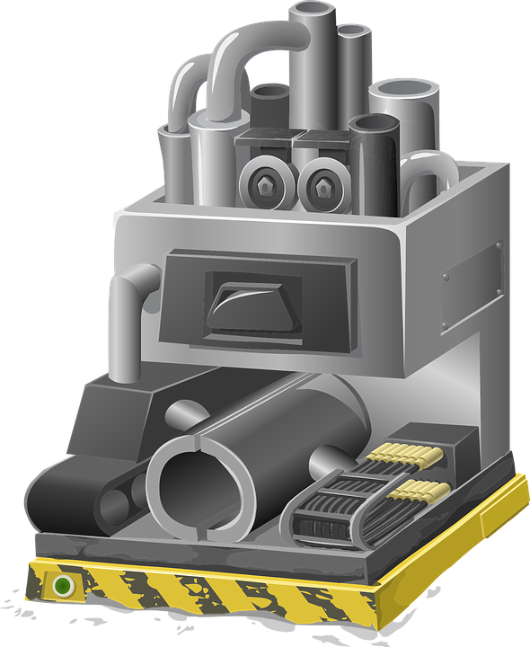
Event Generating
System

Slide 21
__time | ip_address | page_id | user_id
+

Slide 22
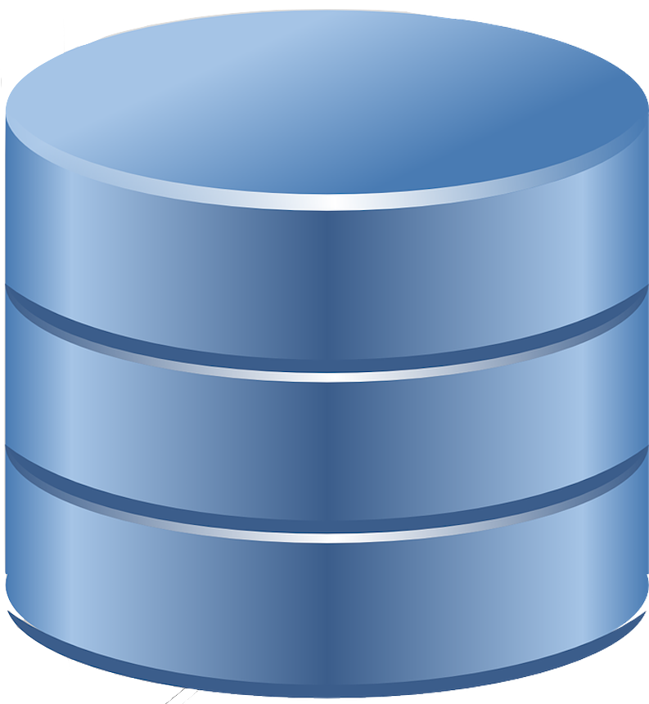


Imply Polaris

Slide 23
Event Generating
System
Imply Polaris

Slide 24

Polaris APIs

Slide 25





Slide 26
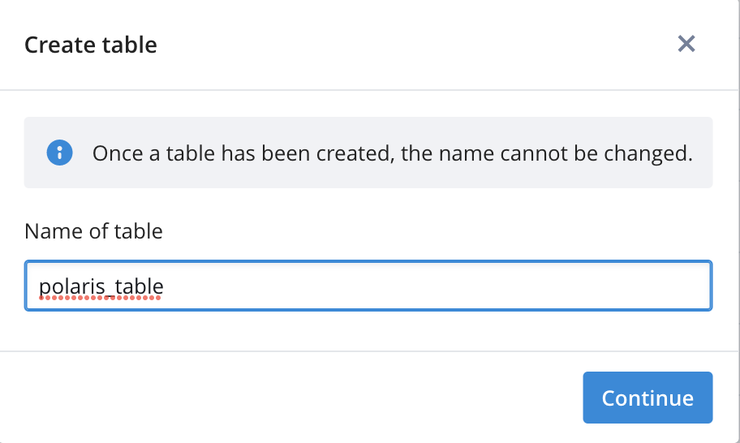
polaris_table

Slide 27
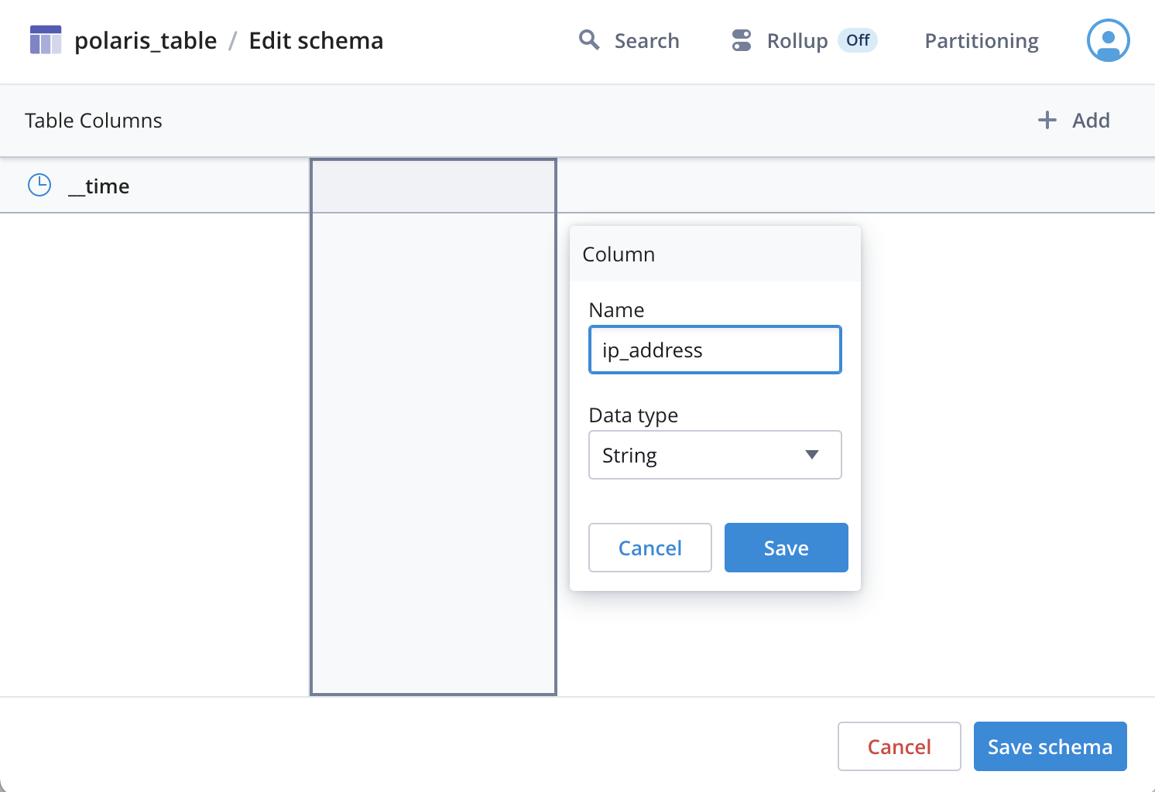

Slide 28

curl --request POST "https://id.imply.io/auth/realms/$ORGANIZATION_NAME/protocol/openid-connect/token" \
--header "Content-Type: application/x-www-form-urlencoded" \
--data-urlencode "client_id=$CLIENT_ID" \
--data-urlencode "client_secret=$CLIENT_SECRET" \
--" \
my_organization
export ORGANIZATION_NAME=my_organization
ORGANIZATION_NAME
my_api_client
CLIENT_ID
CLIENT_SECRET
export CLIENT_ID=my_api_client
my_client_secret
API
export CLIENT_SECRET=my_client_secret
/root/process-monitor-producer.sh ISO CSV 100 > /root/raw_data.csv
/root/process-monitor-producer.sh ISO CSV 100 \
| python3 /root/send_events.py

Slide 29
curl -s -X 'POST' \
-H 'Content-Type:application/json' \
-d '{"query":"SELECT * FROM \"process-data\""}' \
http://localhost:8888/druid/v2/sql \
| jq -c .[] > rows.json
SELECT * FROM “process-data”
echo "" > /root/restore-env.sh
chmod +x /root/restore-env.sh
echo "export ORGANIZATION_NAME=$ORGANIZATION_NAME" >> /root/restore-env.sh
echo "export CLIENT_ID=$CLIENT_ID" >> /root/restore-env.sh
echo "export CLIENT_SECRET=$CLIENT_SECRET" >> /root/restore-env.sh
echo "export IMPLY_TOKEN=$IMPLY_TOKEN" >> /root/restore-env.sh
echo "export TABLE_ID=$TABLE_ID" >> /root/restore-env.sh
echo "export JOB_ID=$JOB_ID" >> /root/restore-env.sh
echo "export TABLE_ID=$TABLE_ID" >> /root/restore-env.sh
echo "export PROJECT_ID=$PROJECT_ID" >> /root/restore-env.sh

Slide 30
{"__time":"2022-04-13T18:59:20.000Z","cpu":16.7,"memory":1.8,"milliseconds":513,"pid":"111","processName":"Broker","seconds":20}
{"__time":"2022-04-13T18:59:20.000Z","cpu":11.1,"memory":1.1,"milliseconds":654,"pid":"114","processName":"MiddleManager","seconds":20}
{"__time":"2022-04-13T18:59:20.000Z","cpu":22.2,"memory":1.3,"milliseconds":283,"pid":"112","processName":"Router","seconds":20}

Slide 31

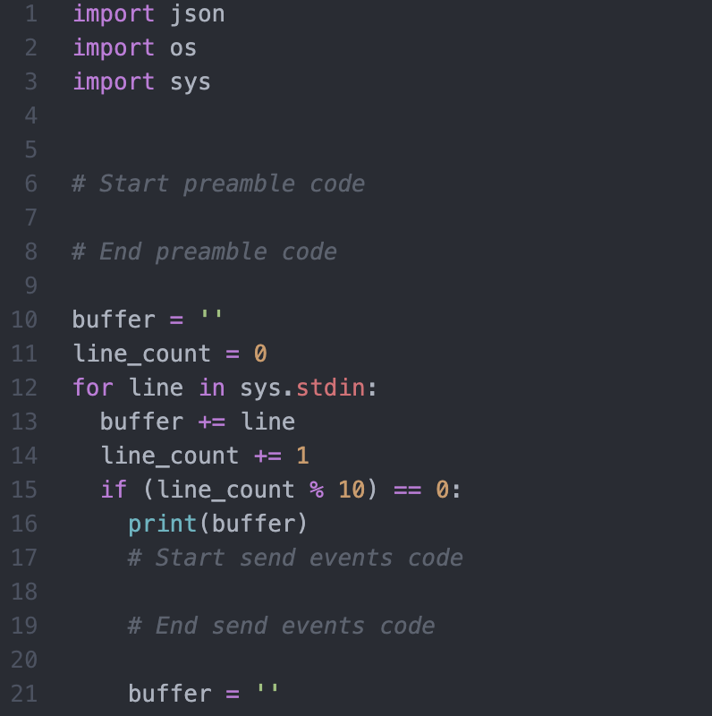

Slide 34
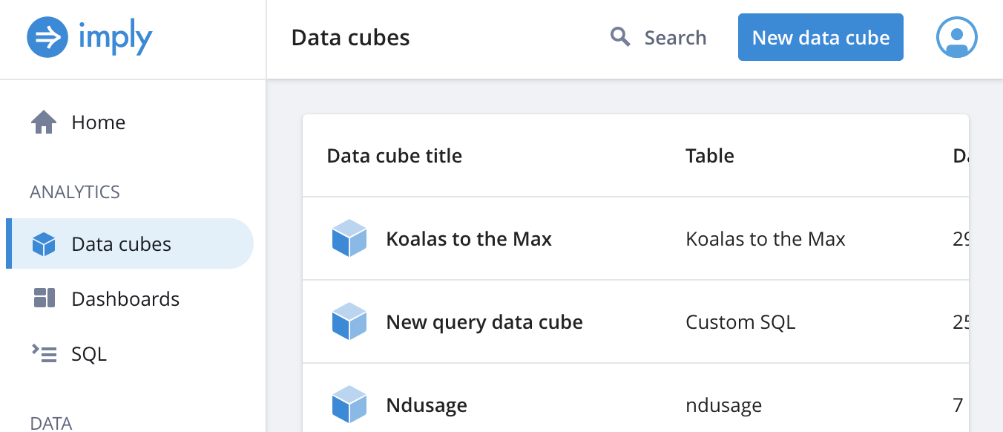

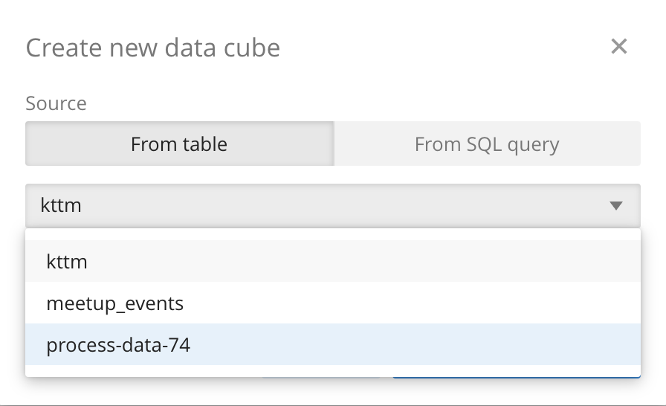
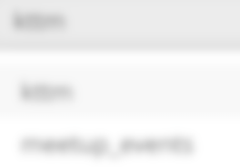
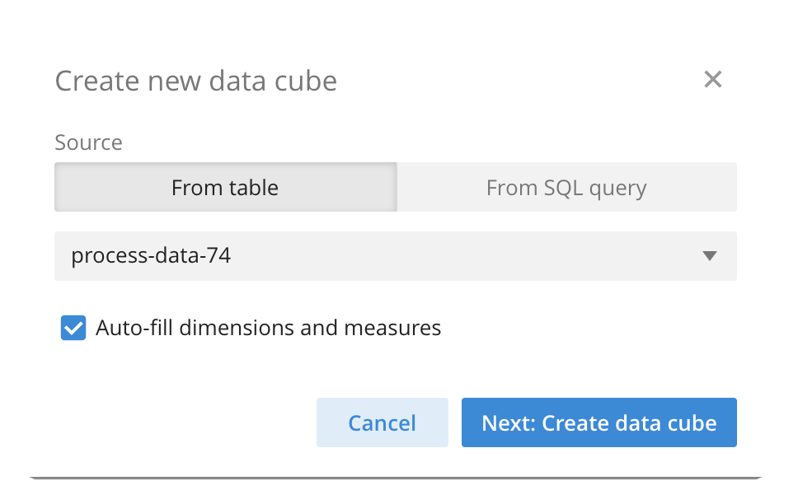
1 - Click here
2 – Click here
3 - Click here
4 – Select the
process-data table
5 - Click here

Slide 36
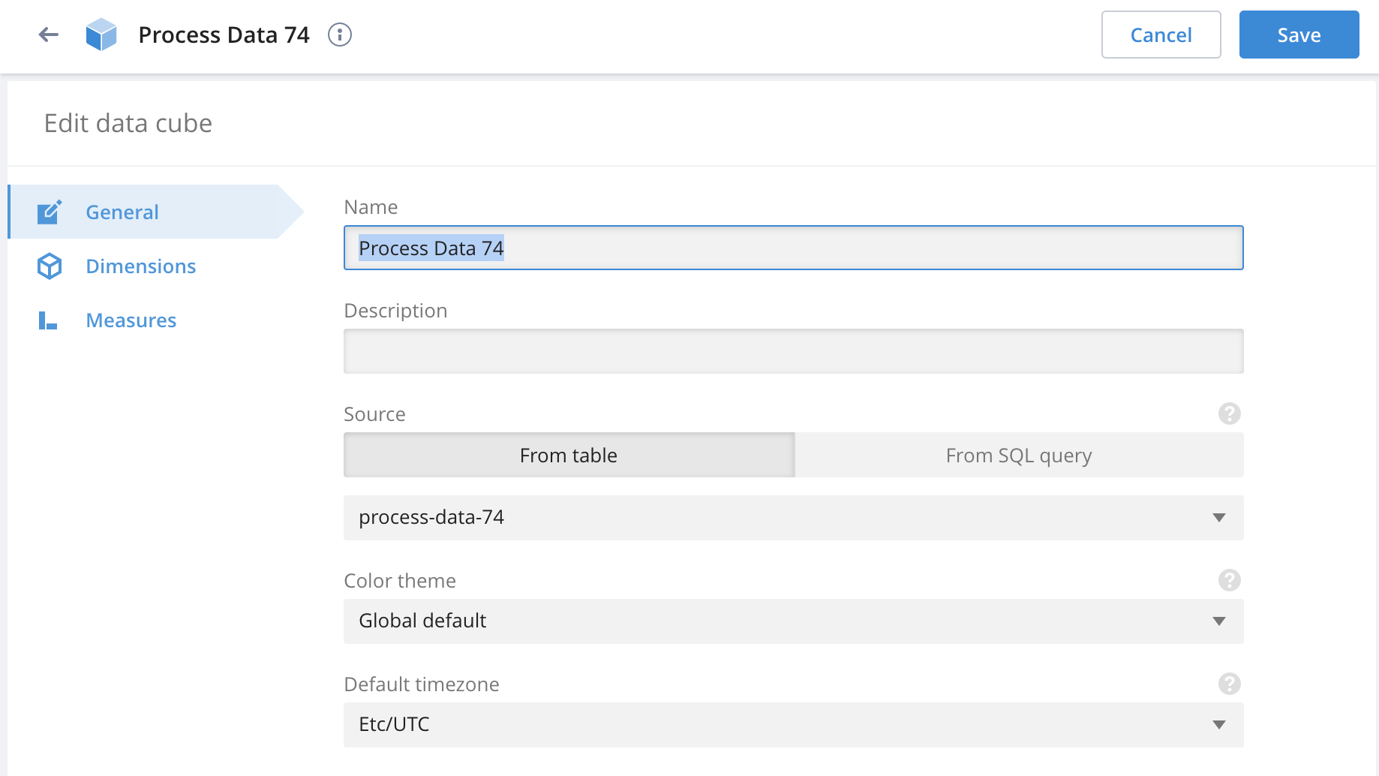
Click here

Slide 37
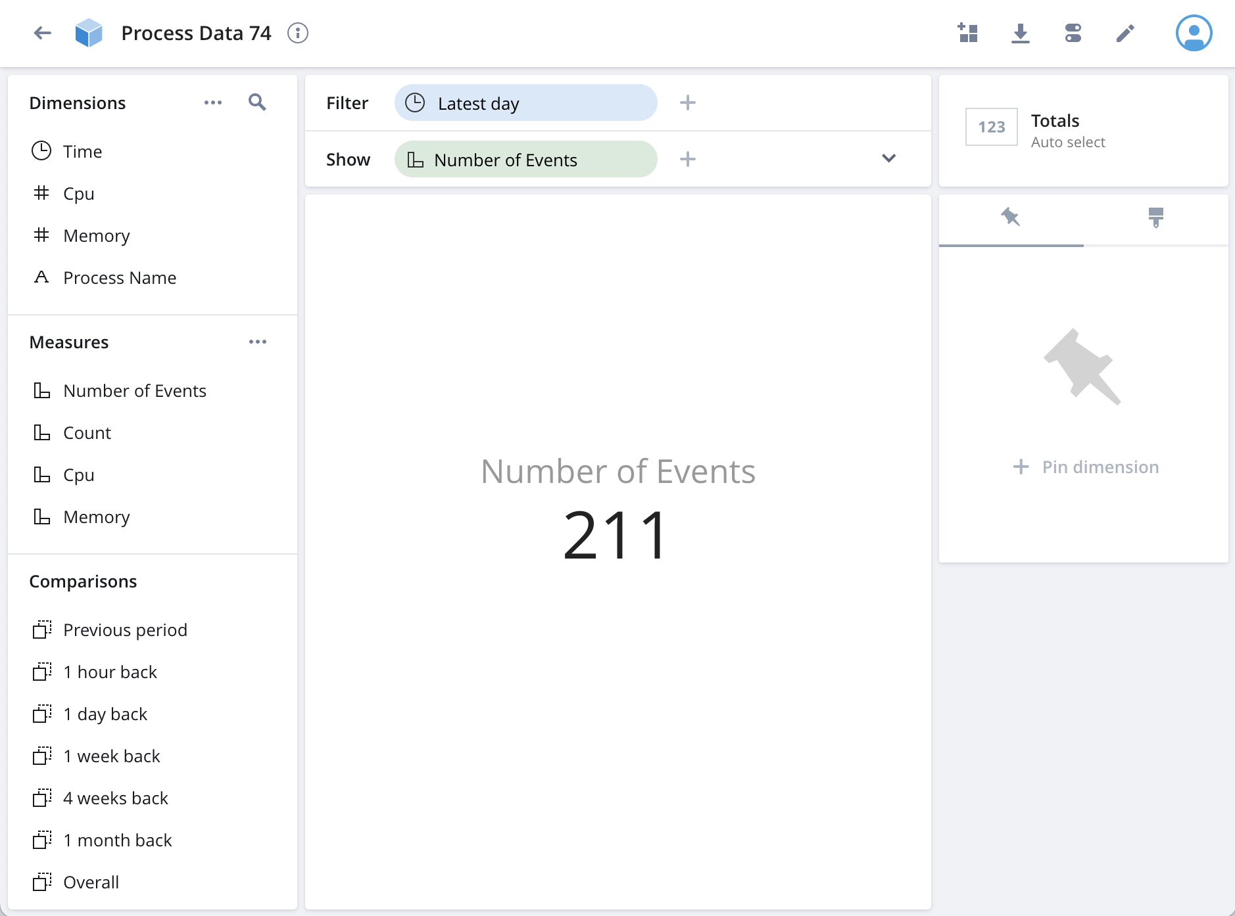

Slide 38
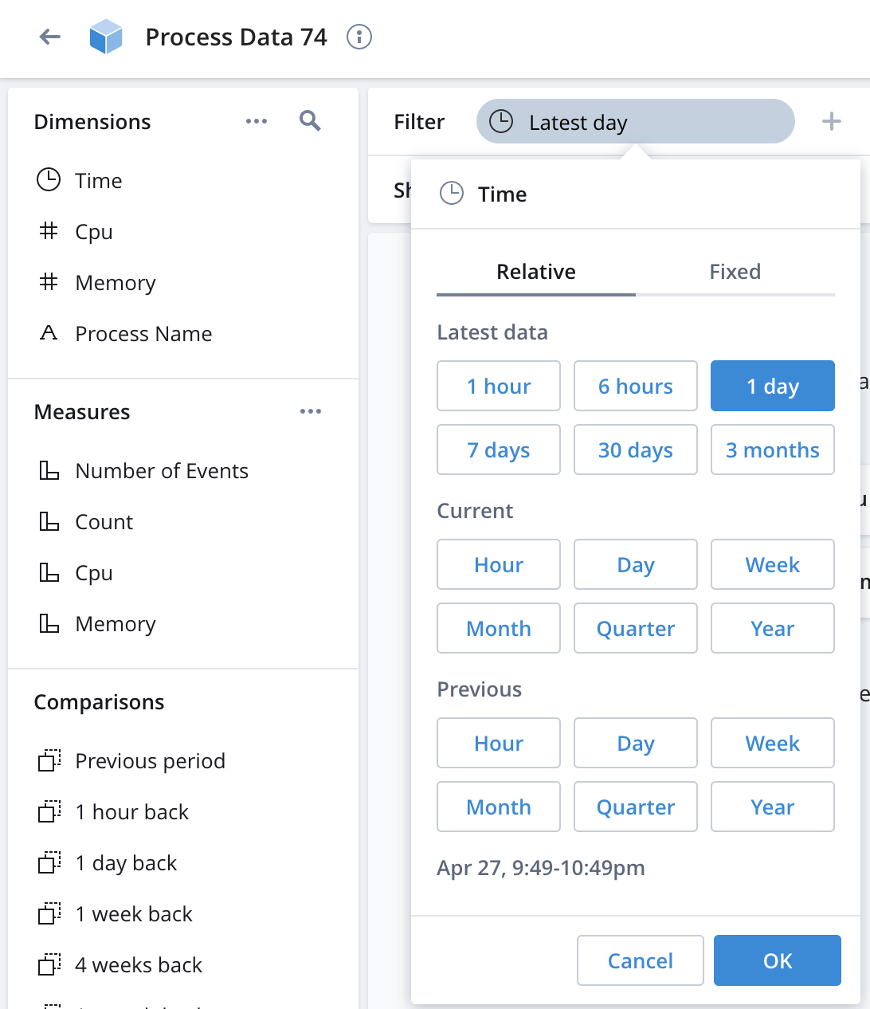
1 - Click here
2 - Click here

Slide 39
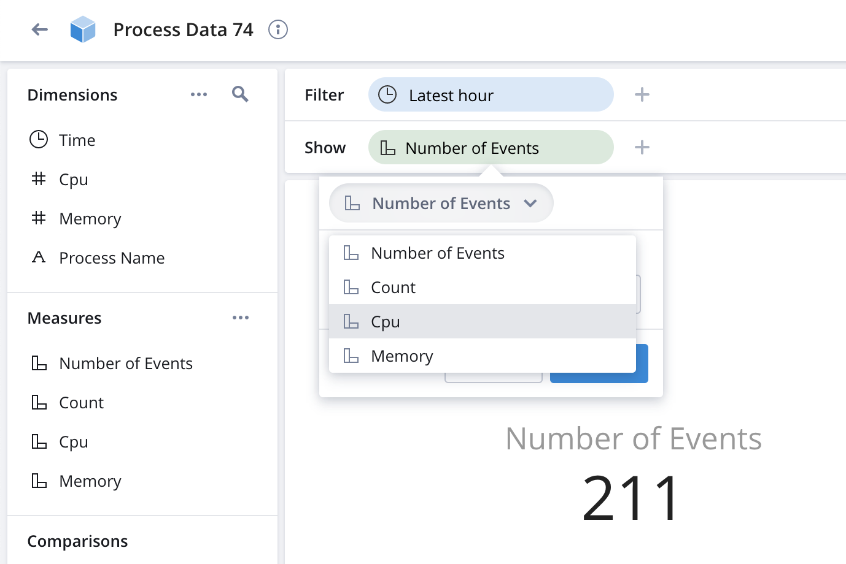
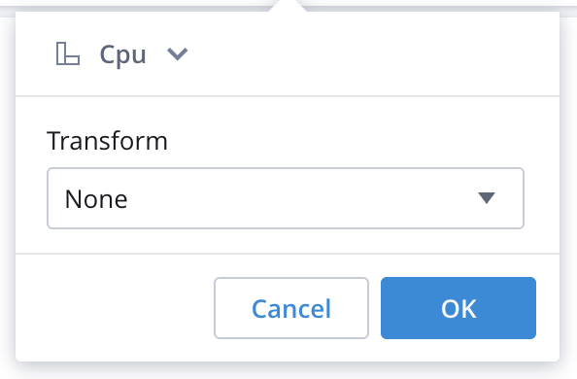
1 - Click here
2 - Click here
3 - Click here
4 - Click here

Slide 40
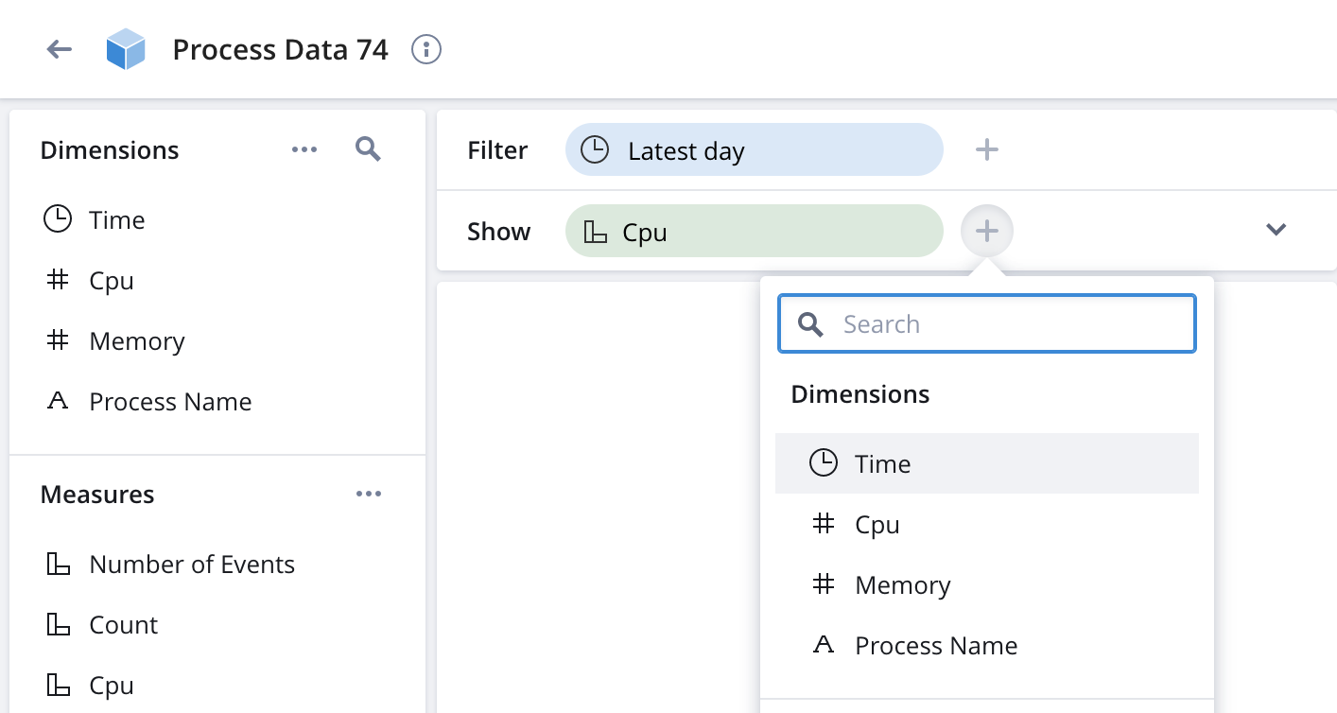
1 - Click here
2 - Click here

Slide 41
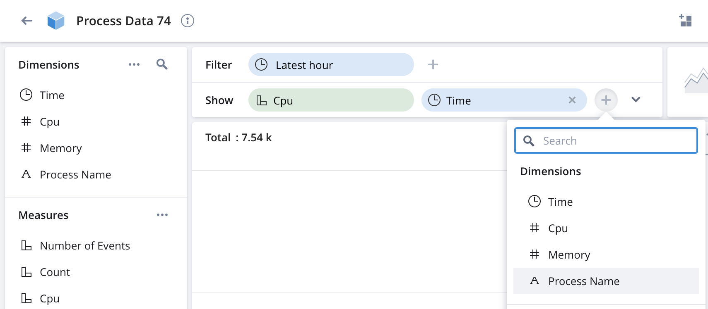
1 - Click here
2 - Click here

Slide 42
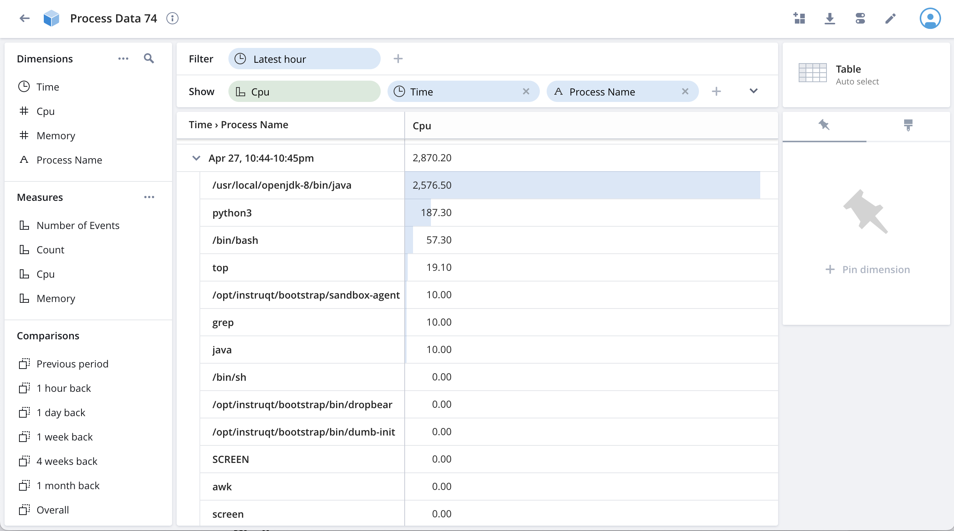

Slide 43
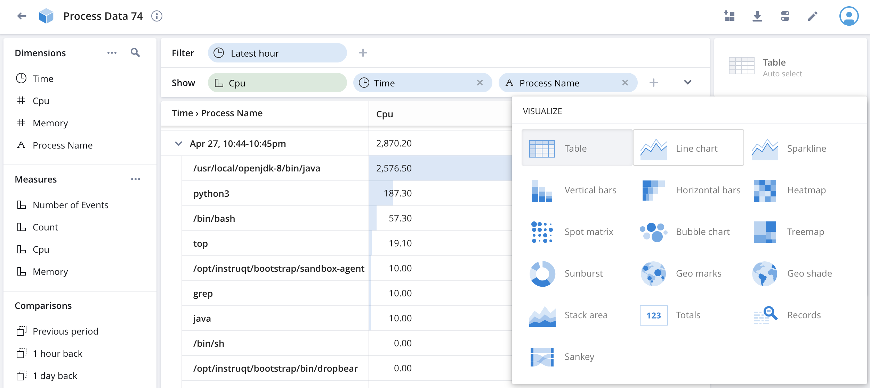
1 - Click here
2 - Click here

Slide 44
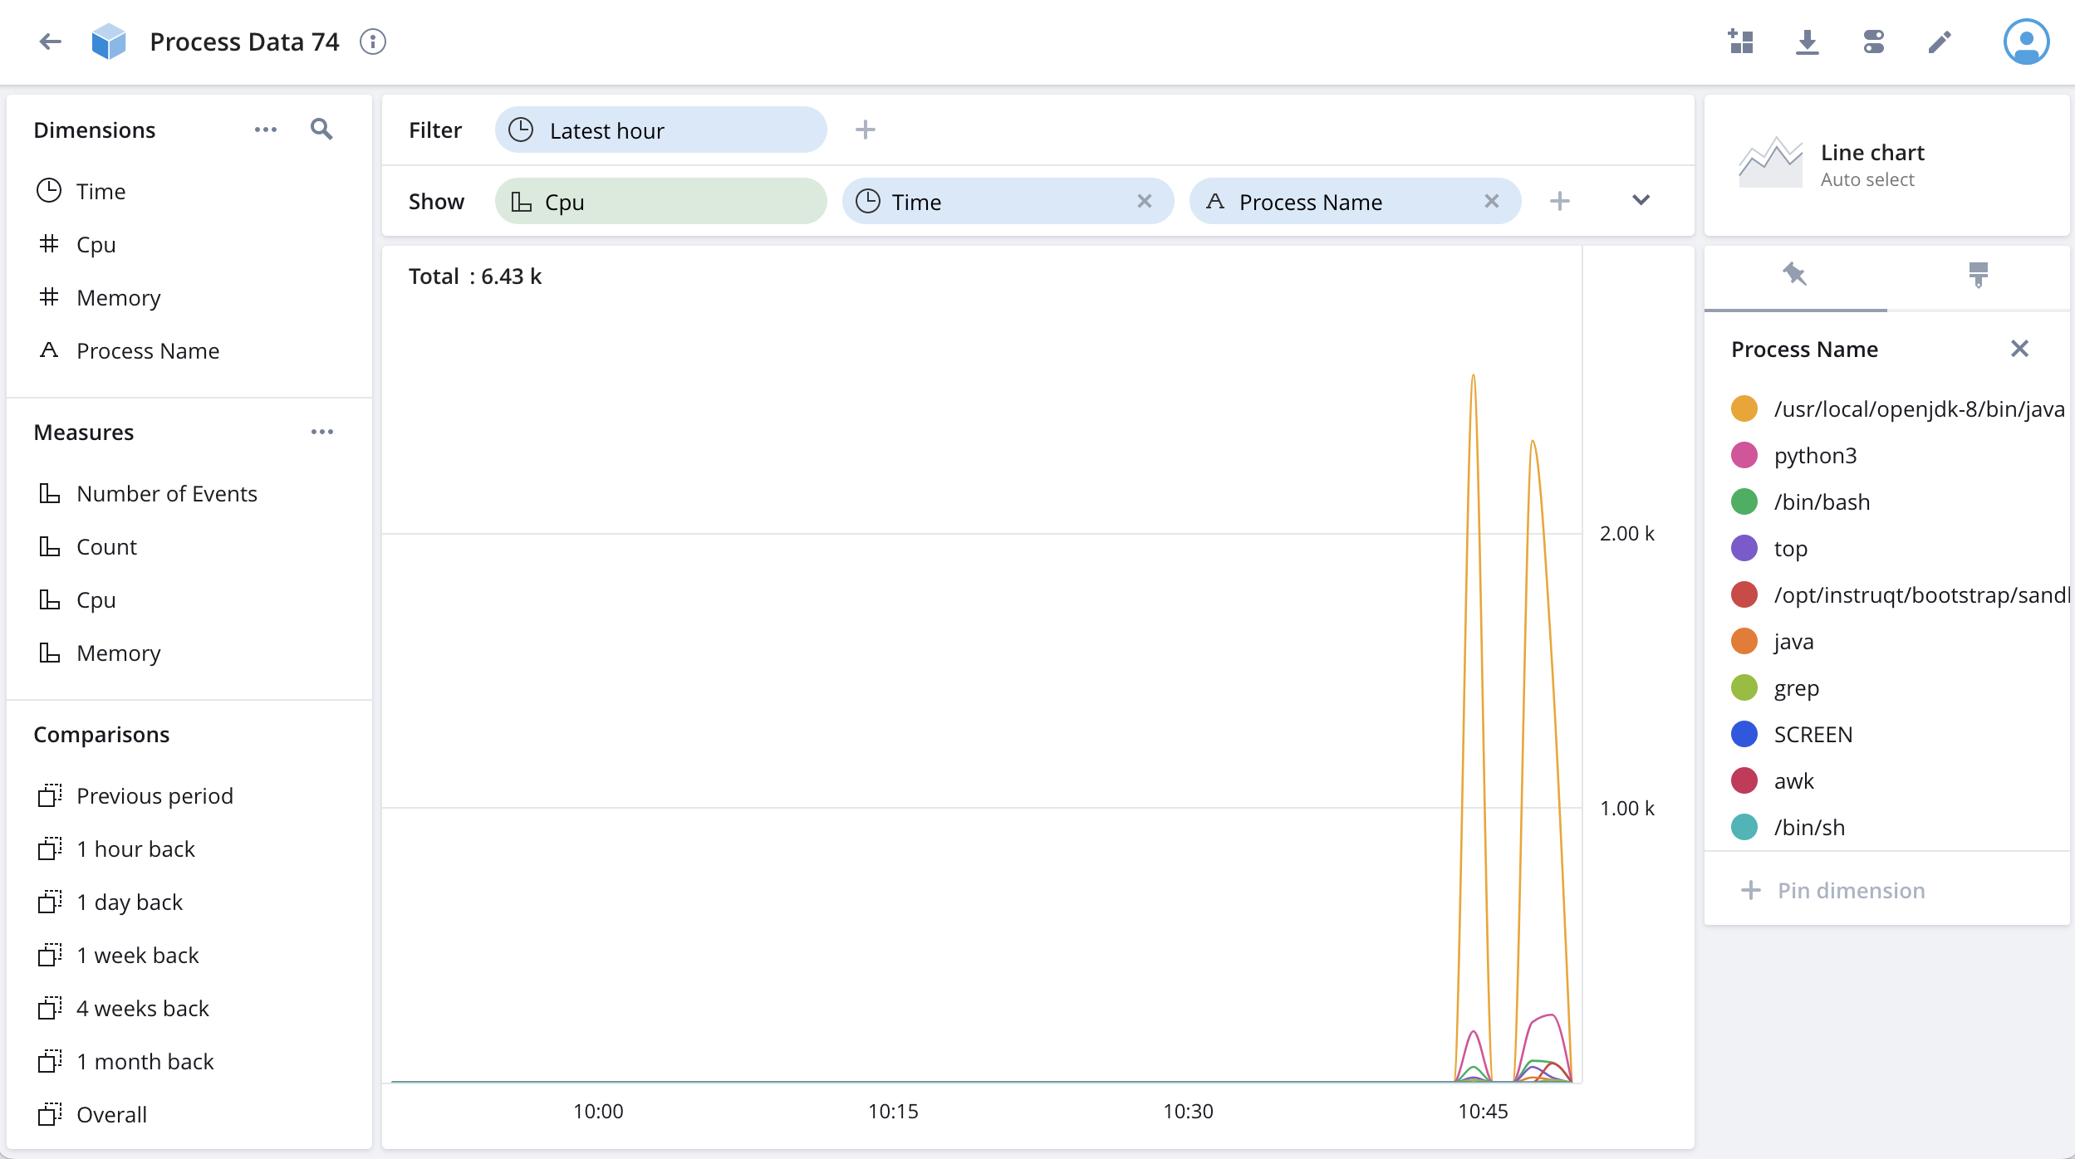
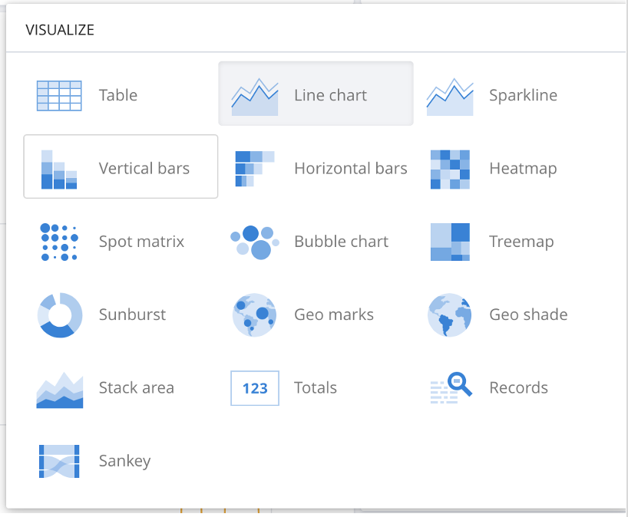
1 - Click here
2 - Click here

Slide 45
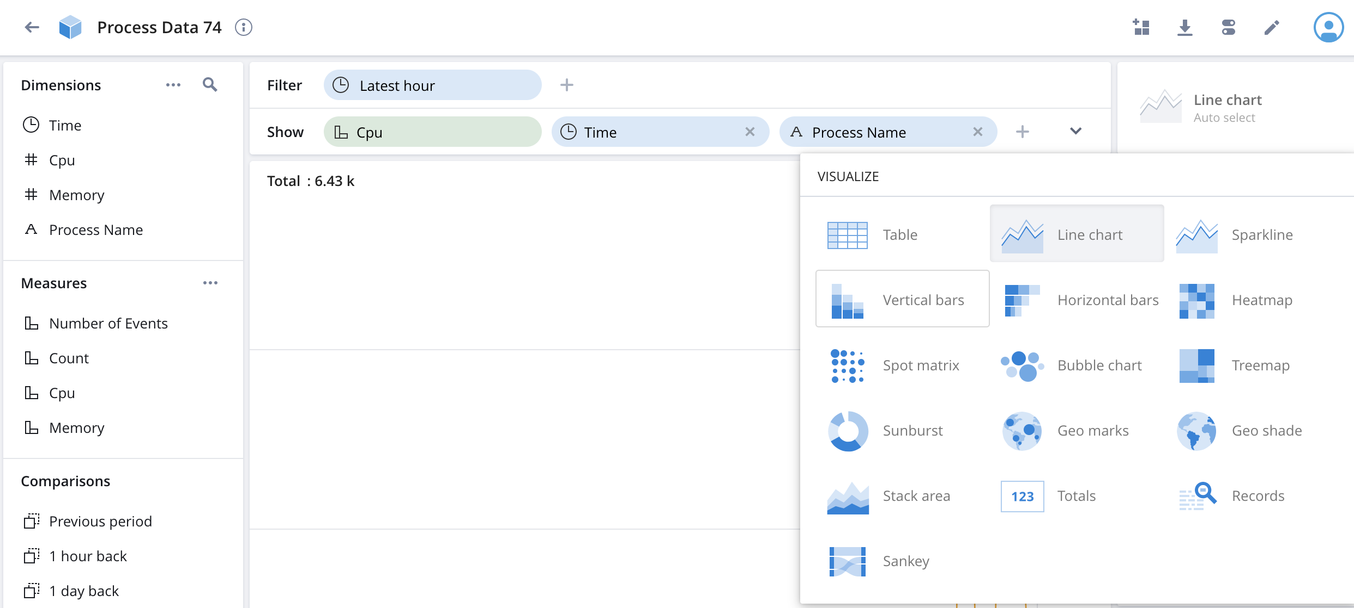
1 - Click here
2 - Click here

Slide 46
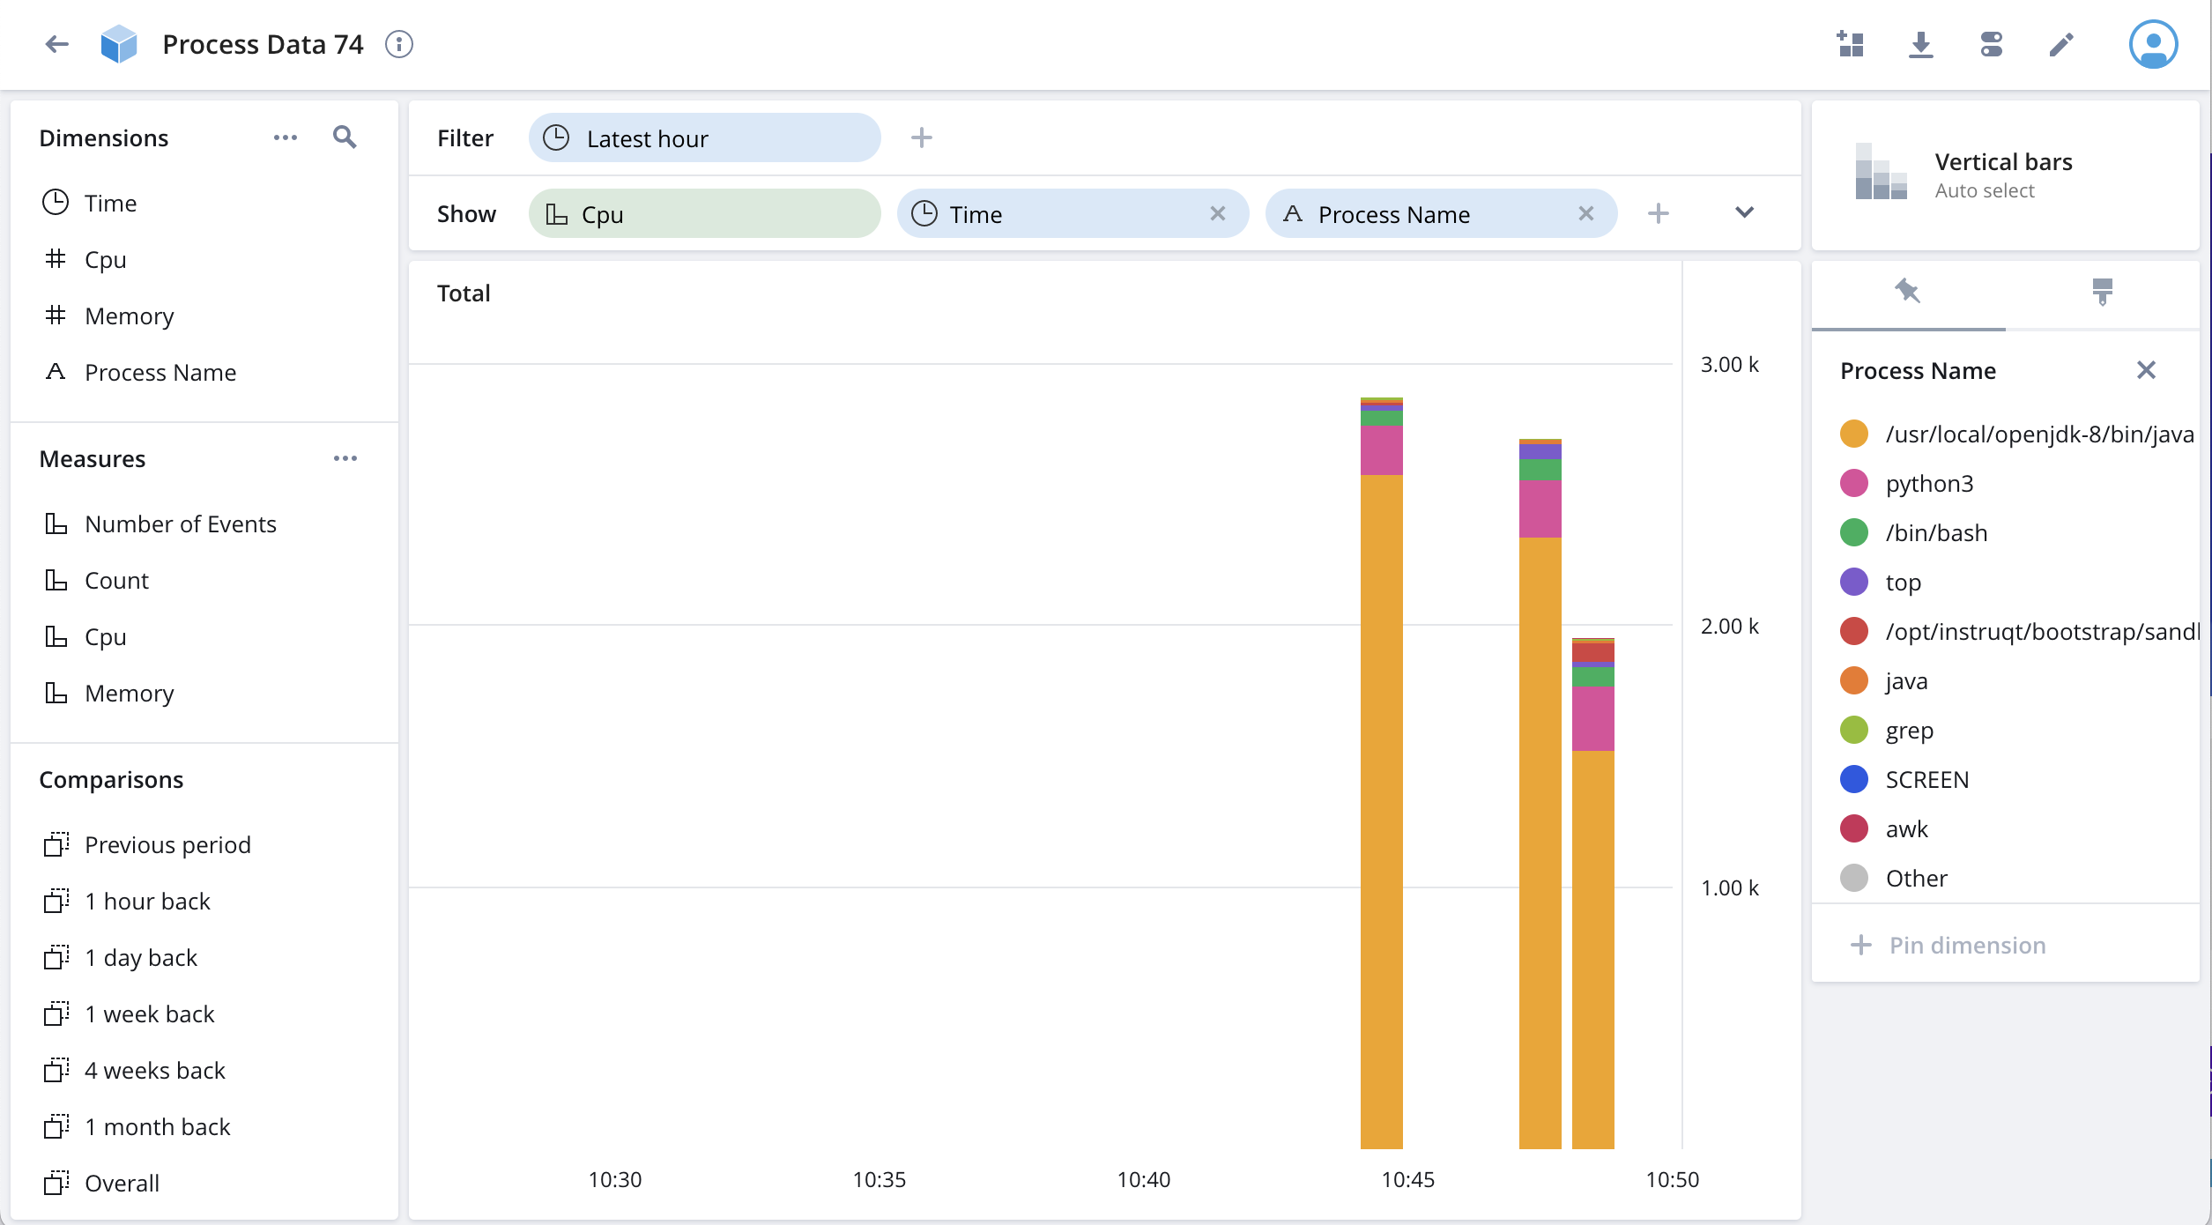

Slide 47
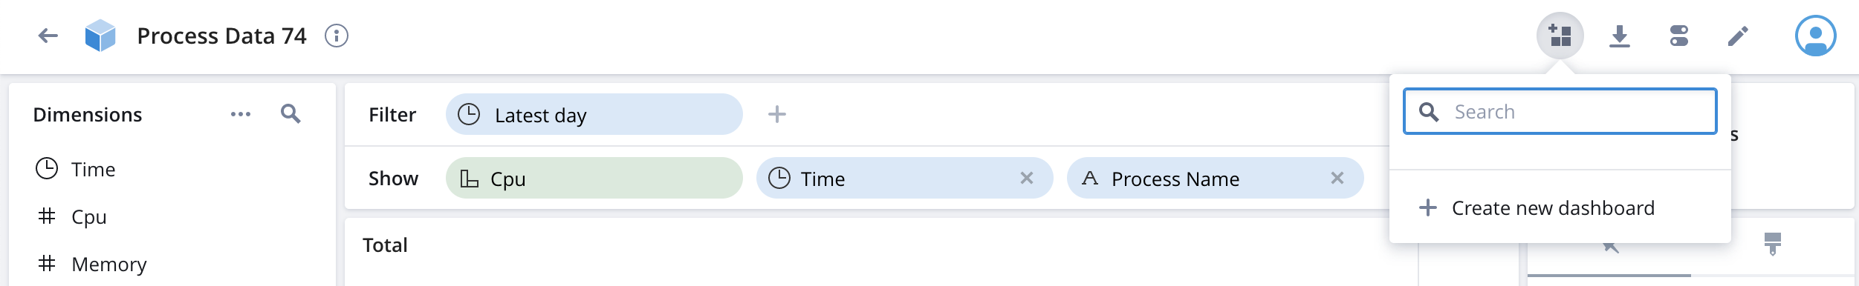
Click here
Then, click here

Slide 48
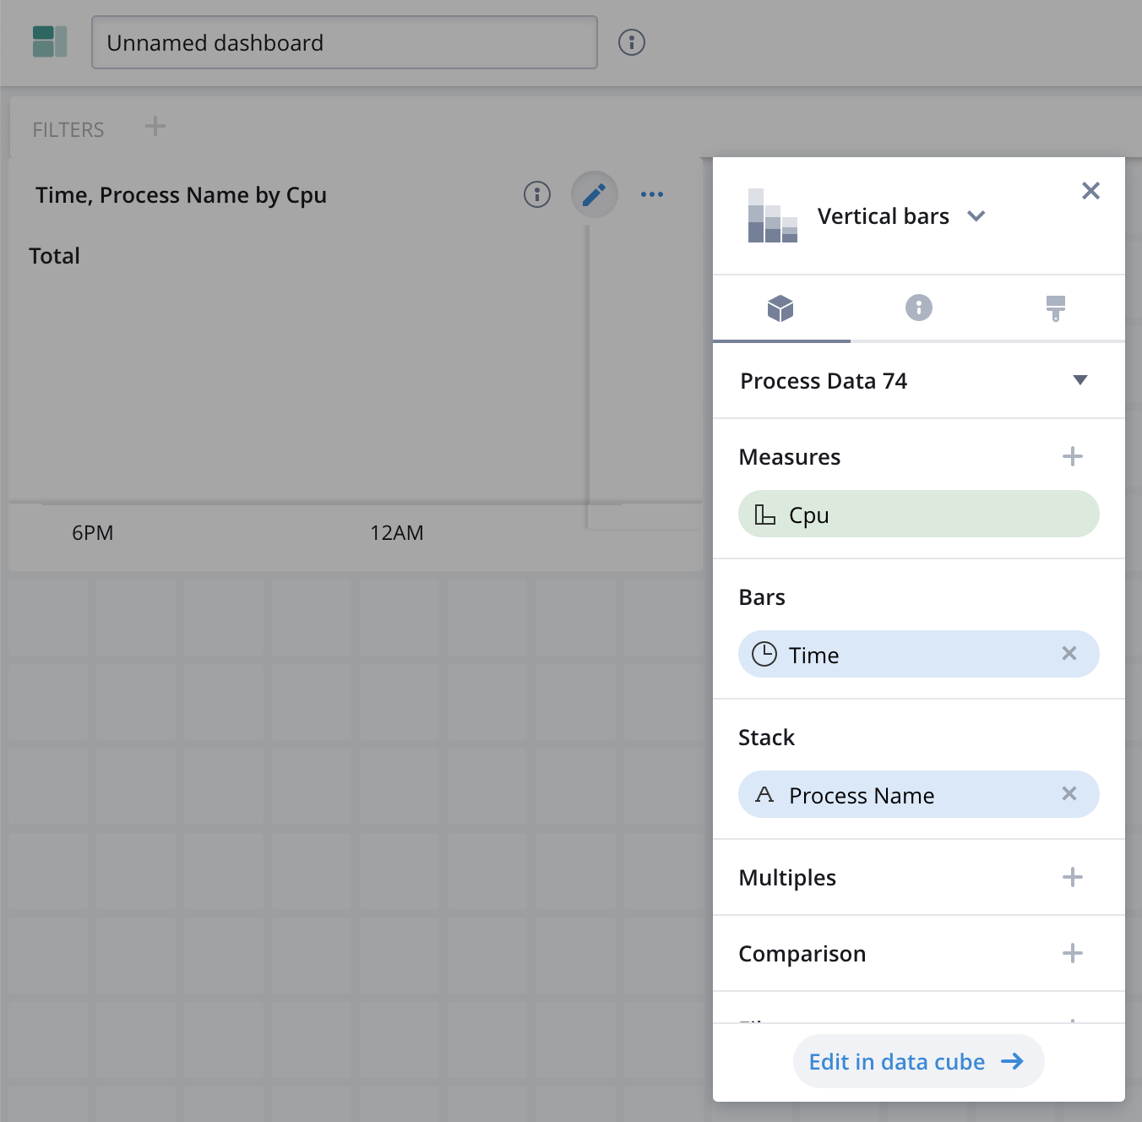
Click here

Slide 49
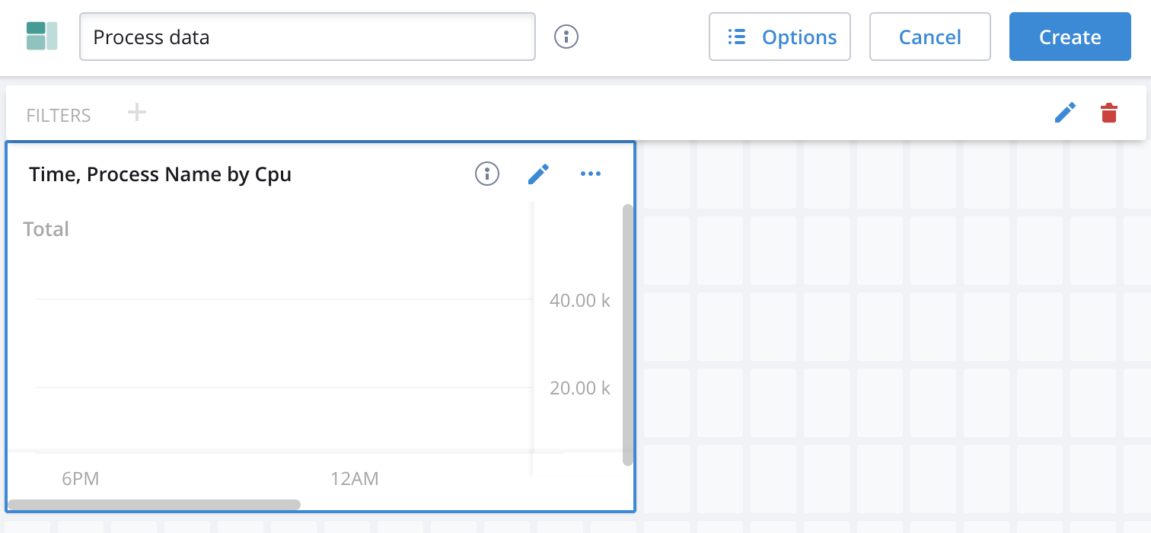
Fill in a dashboard name
Then, click here

Slide 51
Kafka-Polaris Migration

Slide 52
Kafka-Polaris Migration
Wikipedia says Apache Kafka® is:
A distributed event store and stream-processing platform
An open-source system developed by the Apache Software Foundation
Written in Java and Scala
Wikipedia says Apache Kafka® aims to provide:
A unified
High-throughput
Low-latency platform
For handling real-time data feeds.

Slide 54
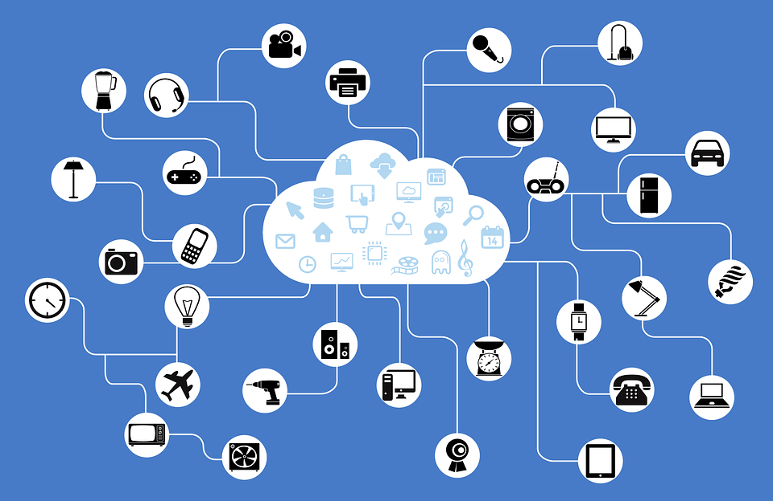

Slide 55
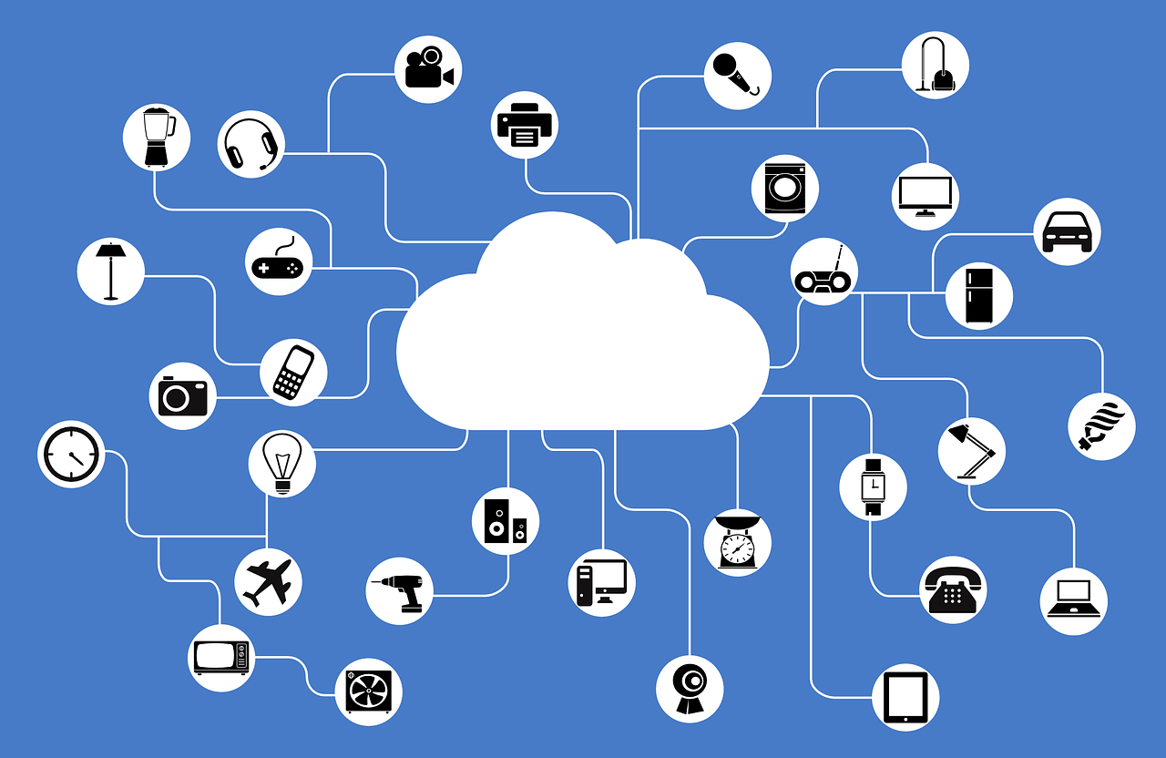




Polaris

Slide 56
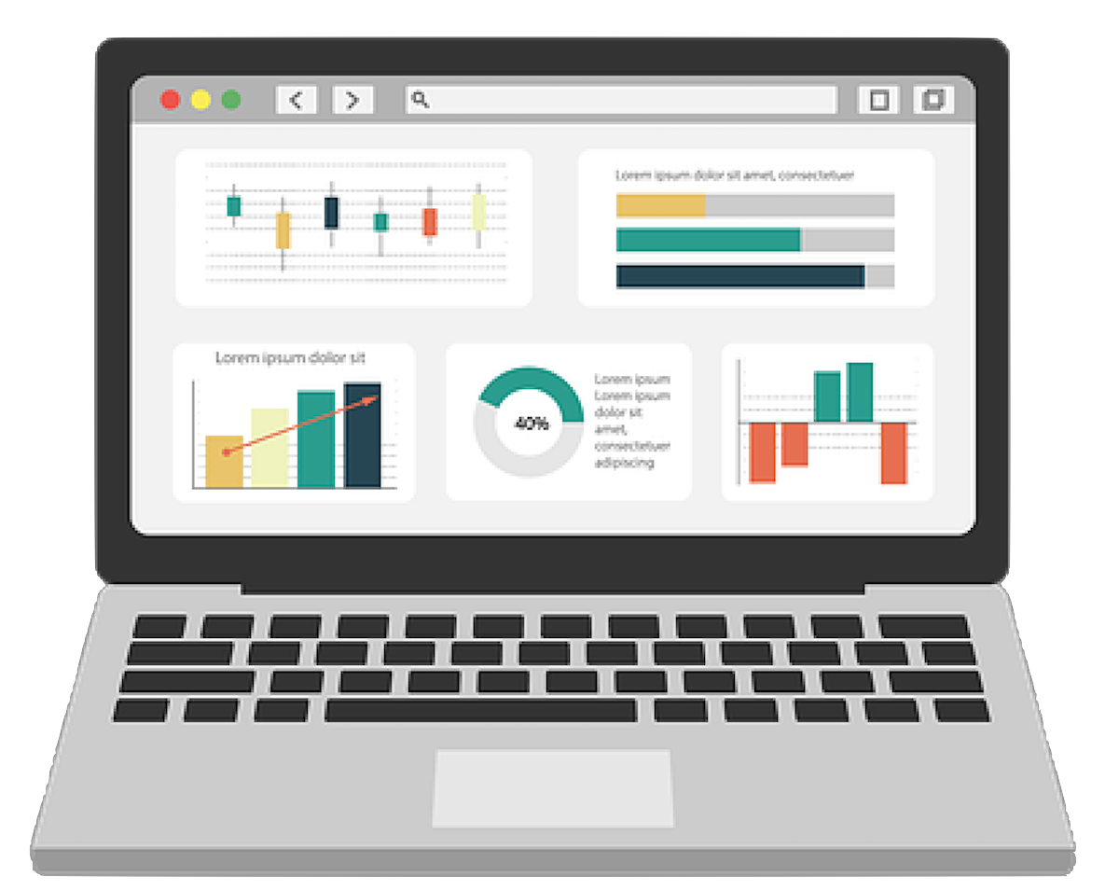
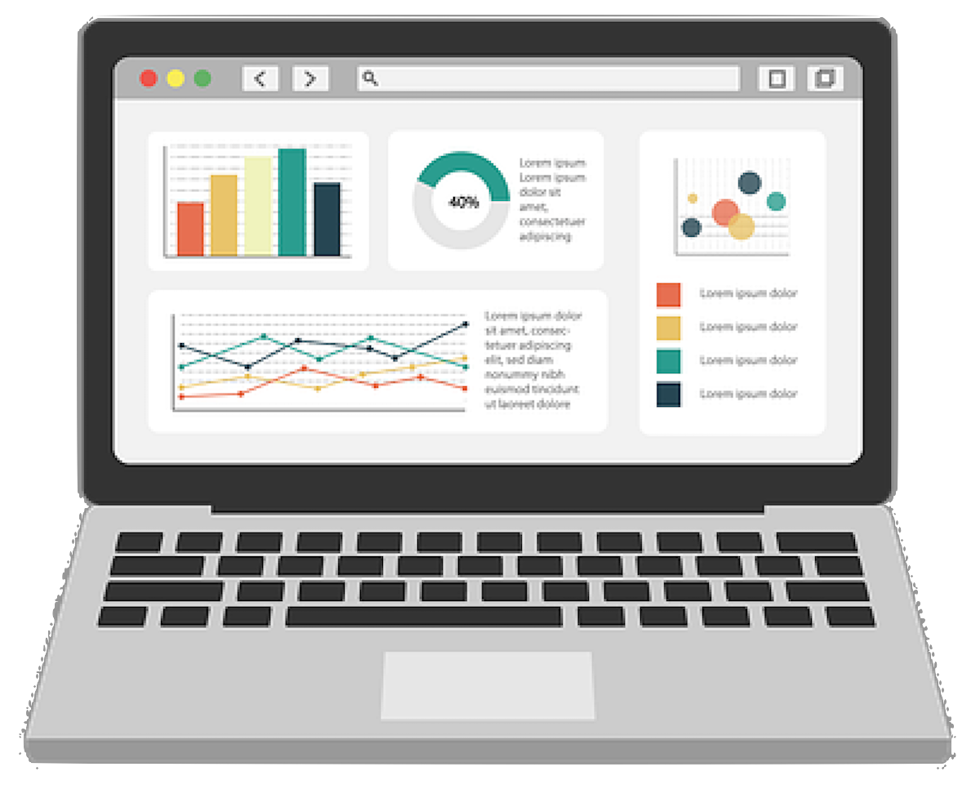

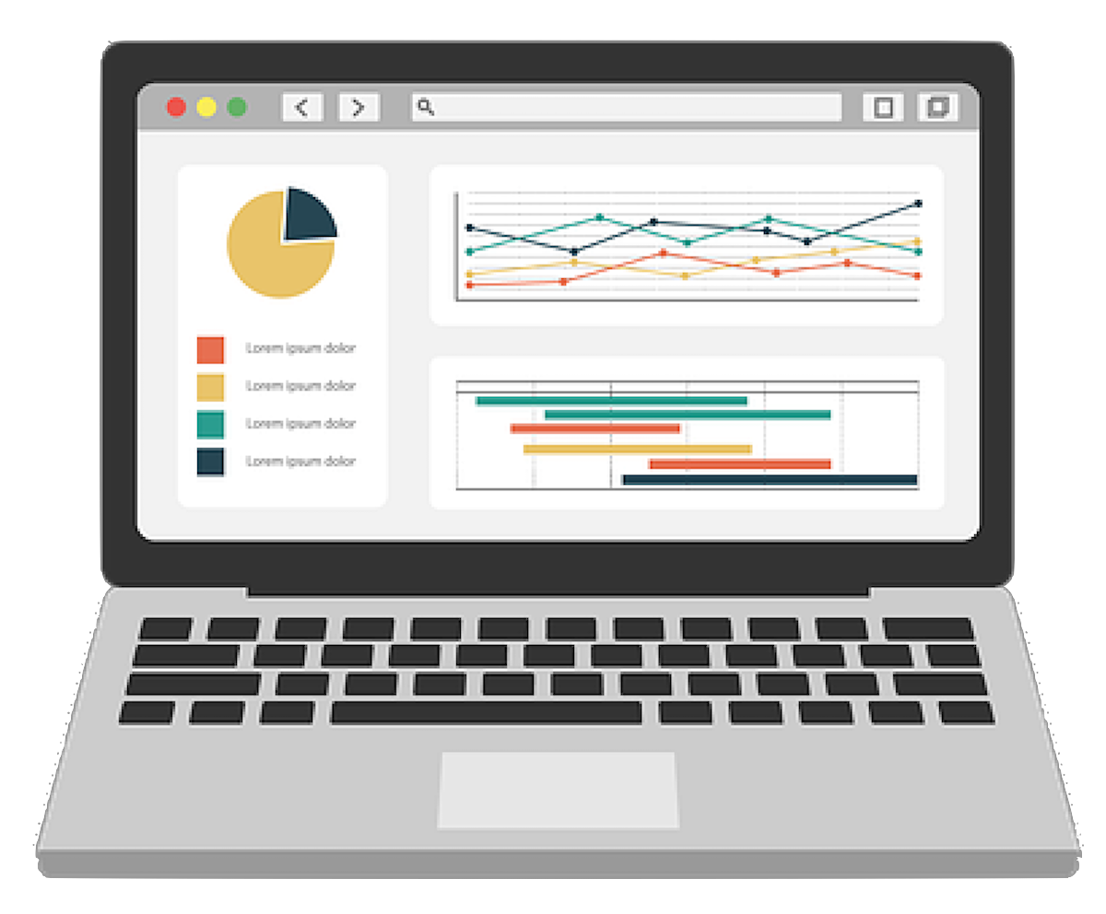
Apache
Druid®

Slide 57


Polaris
Kafka
Consumer

Slide 58
Polaris

Slide 59
Polaris
Clickhouse

Slide 60
Polaris

Slide 61

Kafka
Producer
Kafka
Consumer

Slide 62


Slide 63
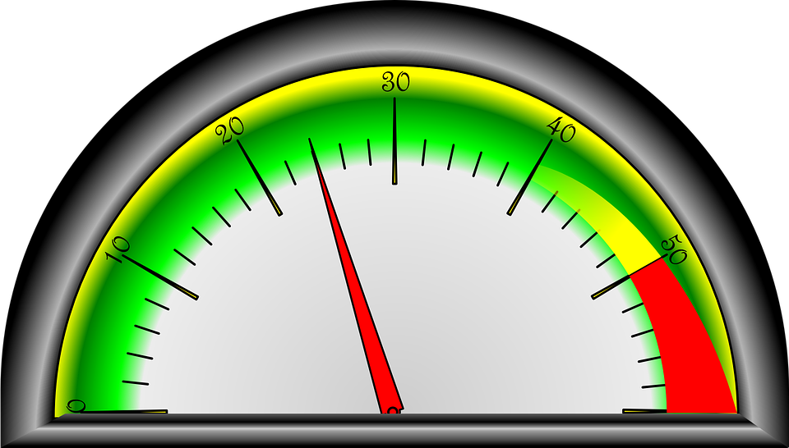

Slide 64






CPU

Slide 65
Memory

Slide 66
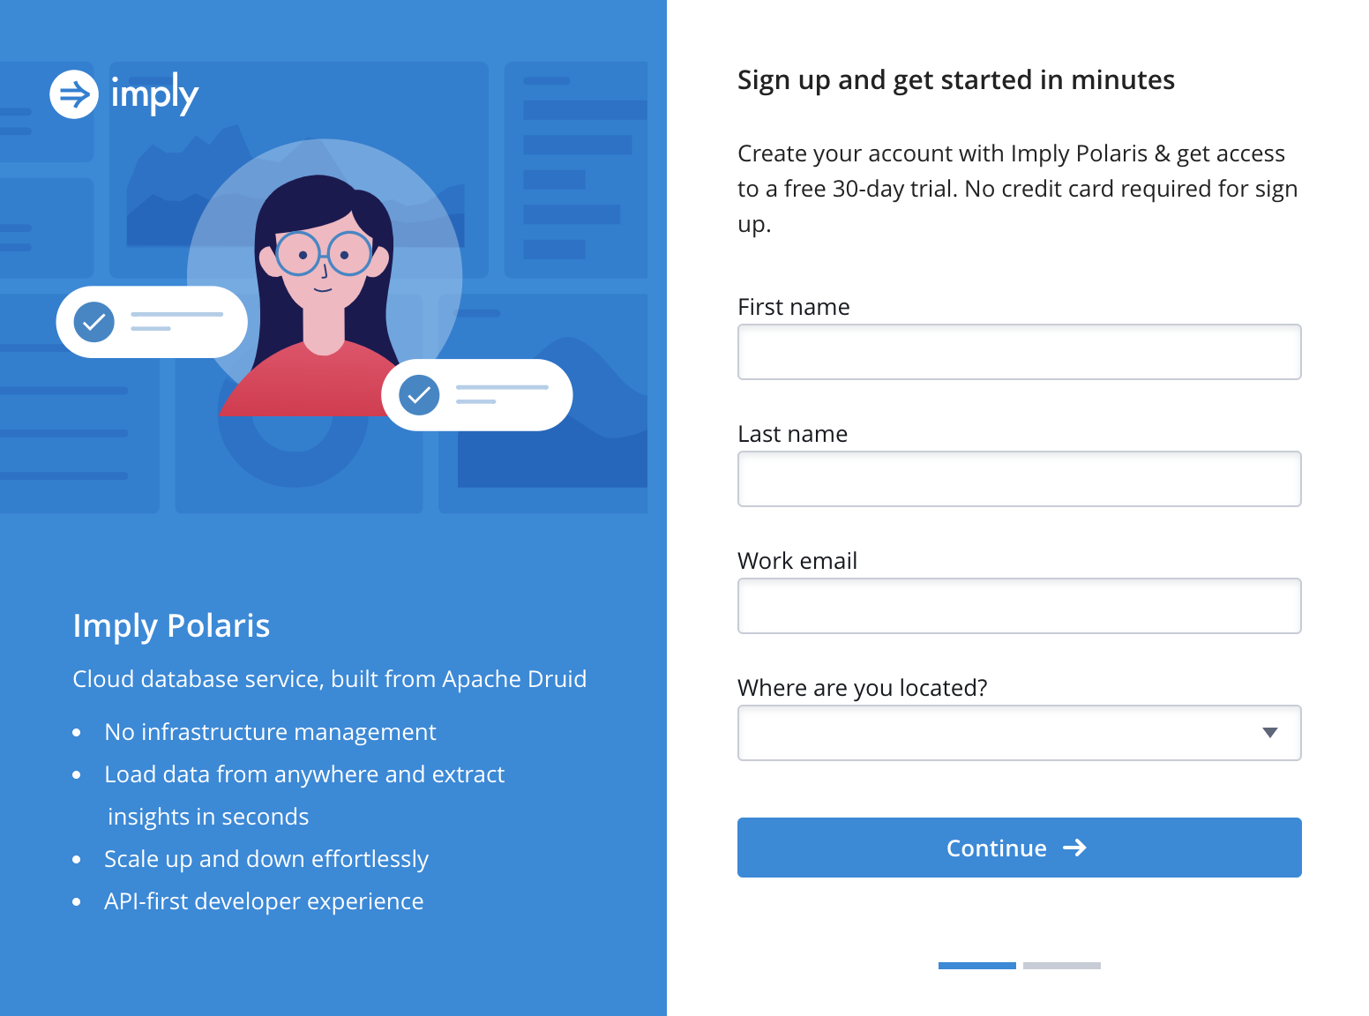

Slide 67
Create Data

Slide 68
Create a Polaris Table

Slide 69
Set Up Kafka

Slide 70
Connect Kafka to Polaris

Slide 71
View Polaris Data

Slide 72
Data Cubes & Dashboards

Slide 73
Set Up a Polaris Table
SELECT __time, ip_address, page_id, user_id
FROM click_stream_events
WHERE "__time"
BETWEEN TIMESTAMP '2015-09-12 00:00:00’
AND TIMESTAMP '2015-09-13 00:00:00'

Slide 74



Slide 75
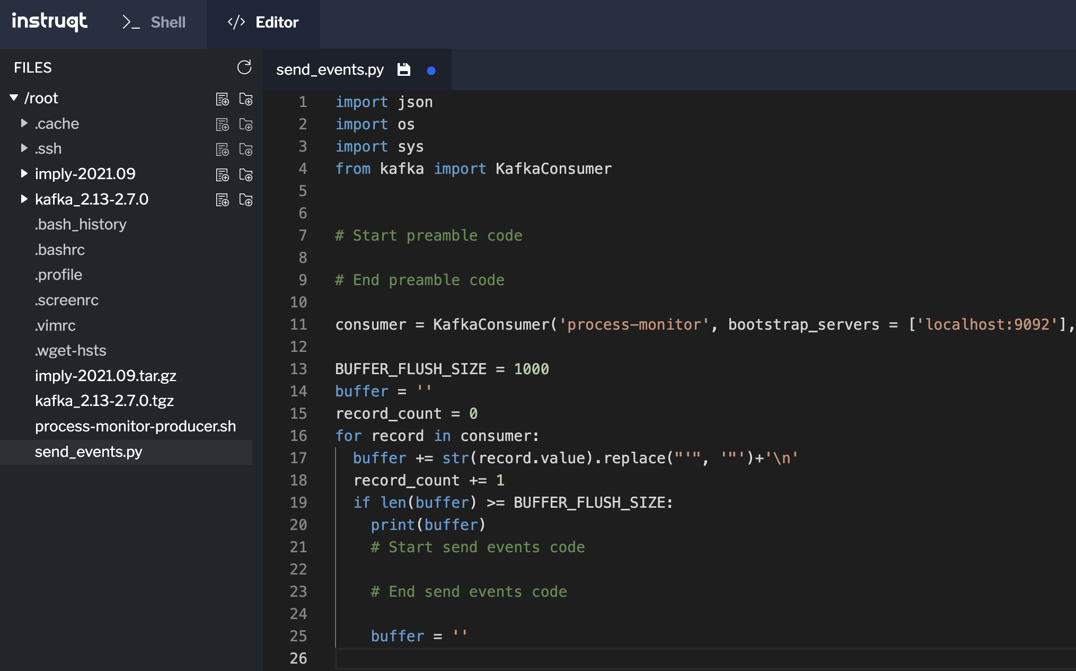

Slide 76


Slide 77
AppsRUs

Slide 78


Slide 79


Data
Cube

Slide 80
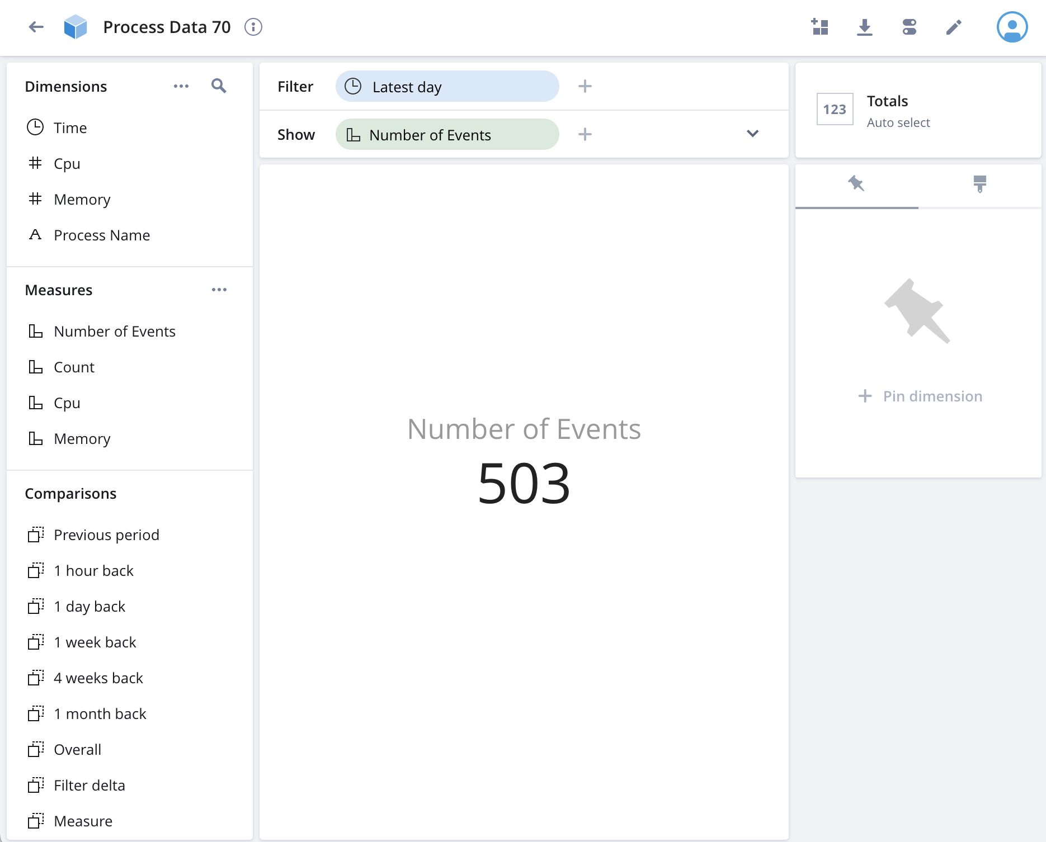

Slide 81
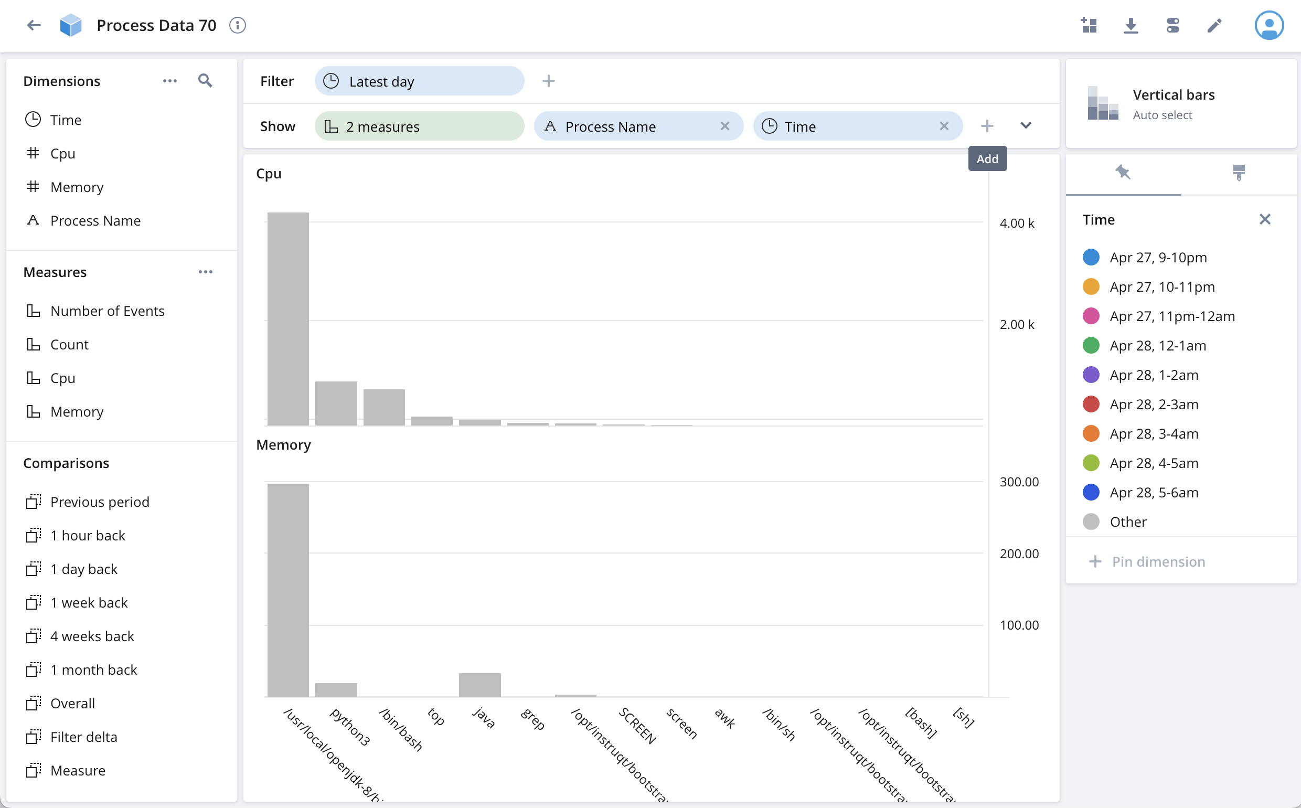

Slide 82
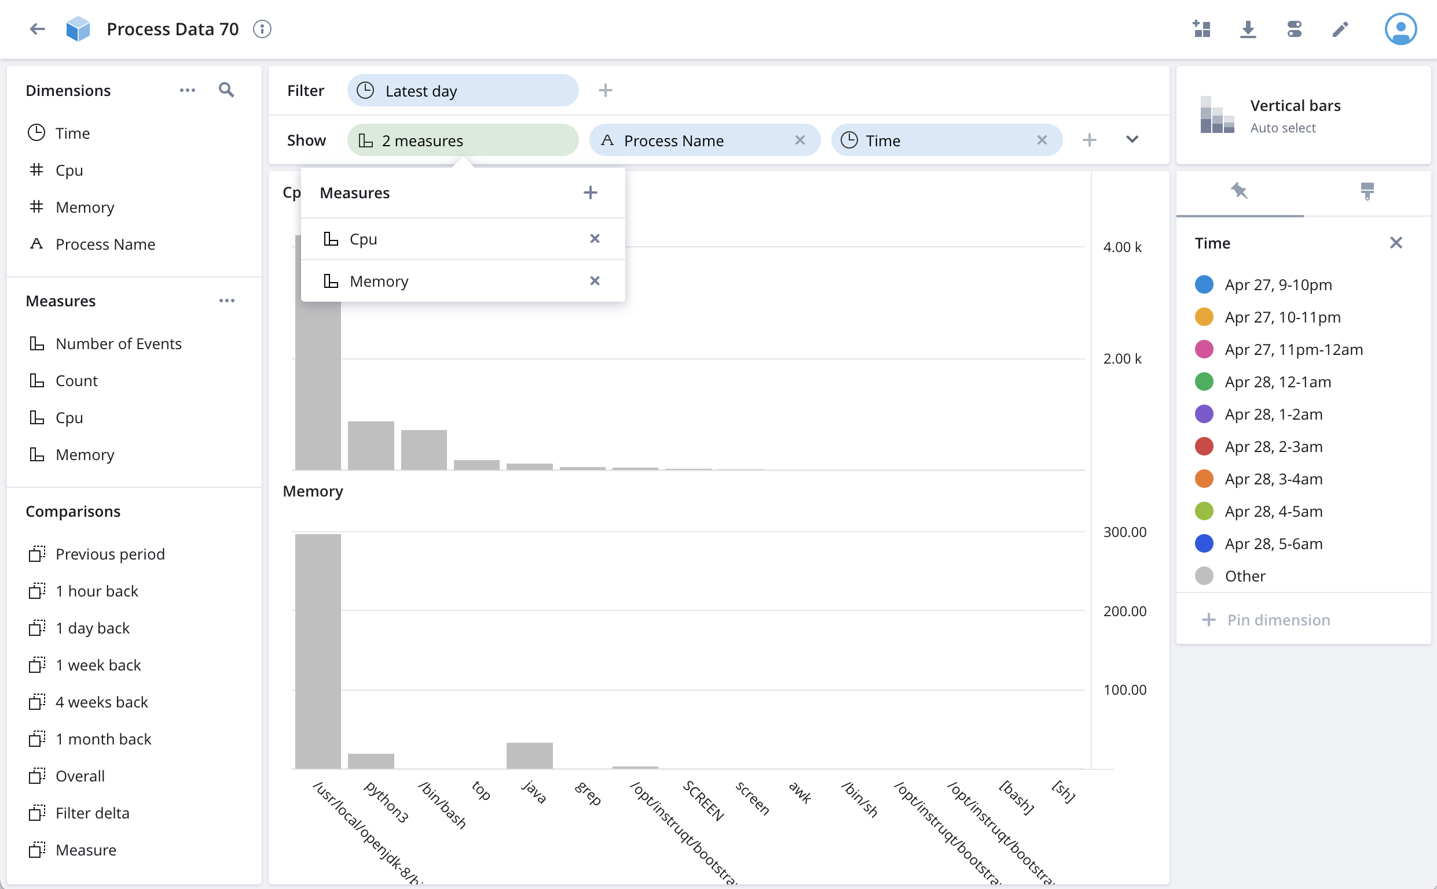

Slide 83
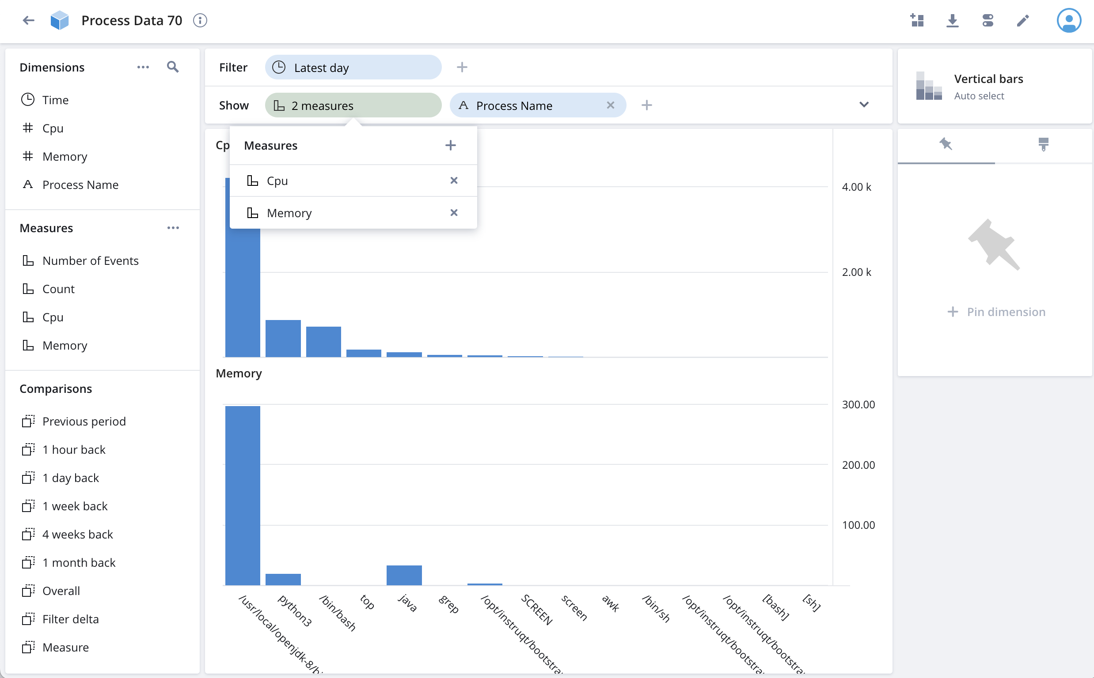
What we want to know
Filters are like a WHERE clause
How to slice
and dice

Slide 84
